Slide 1
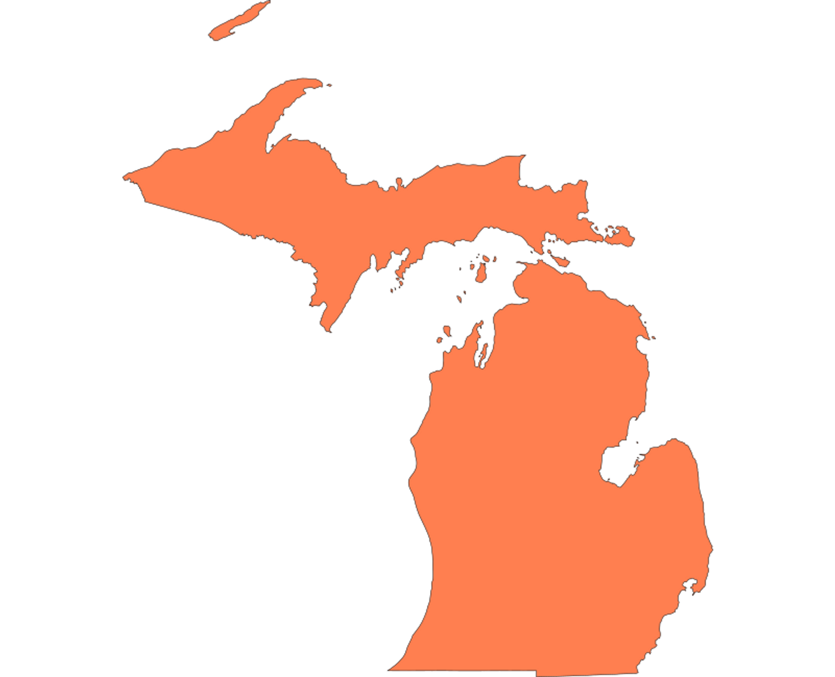
Michigan Regional Adult Initiative
for Skills and Education (MI-RAISE) Design Lab
Convening
January 23, 2024
Notes:
Jeremy
-Please go to the upper right corner of your pic or to your name on the participant list and rename yourself to include your institution
-This is the first of several workshops designed to share strategies and promising practices that can help your institution identify focal areas you may want to develop as part of a grant proposal and your college’s overall approach to increasing recruitment, enrollment, persistence, and completion for adult learners.
We’ll share a few reminders about the process, timeline, partners, and next steps.
-We’re excited that you’re here, and we’re looking forward to diving in.
-

Slide 2
Welcome!
In the chat…(just kidding)
So great to see you!

Slide 3
Agenda
Welcome and Introductions
Recruiting Adult Learners
Lunch
Breakouts
College APP Service Area
Labor Market Info Overview
Power Mapping: Identifying and Engaging Key Stakeholders
Next Steps
MI-RAISE Design Lab
Notes:
Jeremy
-------
AK suggested talking points for Jeremy’s opening
Goal of the MI-RAISE Design Lab
--The goal of this 6 month process is to help you and your colleagues build strong, strategic, actionable plans for significantly enhancing and improving your ability to serve adult learners.
In the near future, starting with but not limited to, the first round of IIA grants, resources will be made available to support institutional capacity for more effectively meeting the needs of adult learners. To be competitive for these resources, institutions and partnerships will need to demonstrate that they have undertaken a careful, planful process in developing proposals. The MI-RAISE Design Lab has been designed to provide a light, but structured process for building out strong project plans.
--The reason we’re taking this approach is because we know from listening to you in a variety of settings that 1) you need resources to do important work, 2) you don’t have a lot of time to think strategically, because you’re so busy working every day on the huge array of responsibilities you have, 3) it’s far too easy to work in silos and miss those opportunities to connect across areas in creative ways that can positively impact your students’ experiences, and 4) for most of you, even if it’s in your institutional bones, effectively meeting the diverse needs of today’s adult learners is hard work that requires next-level strategy and coordination.

Slide 4
“All you need is the plan, the roadmap, and the courage to press on to your destination."
~Earl Nightingale, Author

Slide 5
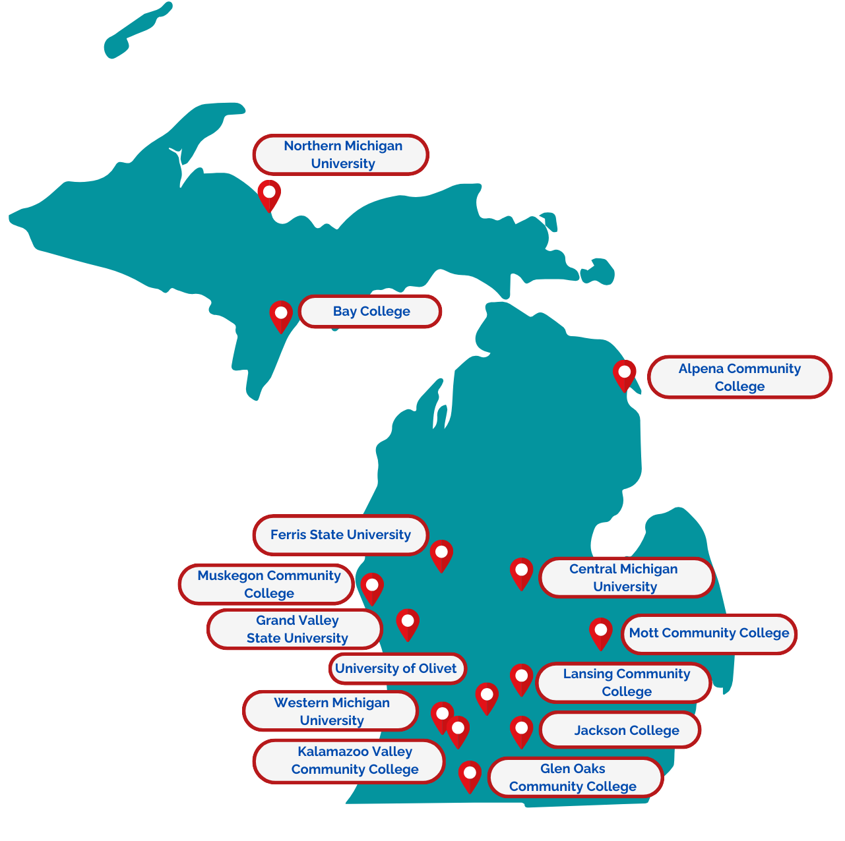
Special Thanks to
Grand Valley State University for hosting!!
MI-RAISE Design Lab
Notes:
Jeremy
We have a great group of partners here that are going to be working together behind the scenes and with you in a coordinated way to provide you with the information, ideas, and support you need to build strong, grounded proposals. The Center is the lead and we’re excited to be in this work (insert ½ a sentence on the Center’s origin and charge).
Education Strategy Group, through a Kresge Foundation grant, is bringing their expertise to provide grounding for the Design Lab participants, to help produce labor market data for participating institutions, and to provide convening support and network learning opportunities. They have created a self-assessment tool that you’ll be provided with and around which you’ll have one 60-90 minute grounding session before the end of the year. Our ESG colleagues will tell you more about that in a moment, but know that the self-assessment discussion will not be an onerous process, but a discussion. You’ll have the opportunity to prepare for the session, but no preparation will be required.
Sova is the design process lead and their team will be working individually with your institutions to tailor a process that will result in compelling, strategic, actionable, grounded proposals for the IIA. In a couple of minutes here, you’ll hear about Sova’s approach to this work, but know that Sova is committed to meeting you where you are and tailoring a process that feels light, fits within the realities of your team’s busy lives, and that helps you build the strongest possible proposals by May.
CollegeAPP will be providing Adult Prospect Pipeline data mining and modeling to help you think strategically and broadly about the opportunities you have in your service region. Additional data analysis of this kind will be helpful to you in the work of building strong, grounded proposals.
TalentFirst will be working with ESG and CollegeAPP to extend our collective capacity to provide you with good information about the broader landscape that your institutions are operating in and the labor market opportunities that exist in your service region.
While the support has been assembled specifically for the purpose of readying institutions to apply for IIA and other grants, we think the insights and support provided by the partners will be of wider benefit to you and your colleagues.

Slide 6
MI-RAISE Design Lab Key Partners
Michigan Center for Adult College Success - Project lead
Education Strategy Group - Technical assistance, labor market data, convening support
Sova - Design process lead, coaching, technical assistance
CollegeAPP - Adult Prospect Pipeline data mining and modeling
TalentFirst - Landscape analysis and Labor market data
MI-RAISE Design Lab
Notes:
Jeremy
We have a great group of partners here that are going to be working together behind the scenes and with you in a coordinated way to provide you with the information, ideas, and support you need to build strong, grounded proposals. The Center is the lead and we’re excited to be in this work (insert ½ a sentence on the Center’s origin and charge).
Education Strategy Group, through a Kresge Foundation grant, is bringing their expertise to provide grounding for the Design Lab participants, to help produce labor market data for participating institutions, and to provide convening support and network learning opportunities. They have created a self-assessment tool that you’ll be provided with and around which you’ll have one 60-90 minute grounding session before the end of the year. Our ESG colleagues will tell you more about that in a moment, but know that the self-assessment discussion will not be an onerous process, but a discussion. You’ll have the opportunity to prepare for the session, but no preparation will be required.
Sova is the design process lead and their team will be working individually with your institutions to tailor a process that will result in compelling, strategic, actionable, grounded proposals for the IIA. In a couple of minutes here, you’ll hear about Sova’s approach to this work, but know that Sova is committed to meeting you where you are and tailoring a process that feels light, fits within the realities of your team’s busy lives, and that helps you build the strongest possible proposals by May.
CollegeAPP will be providing Adult Prospect Pipeline data mining and modeling to help you think strategically and broadly about the opportunities you have in your service region. Additional data analysis of this kind will be helpful to you in the work of building strong, grounded proposals.
TalentFirst will be working with ESG and CollegeAPP to extend our collective capacity to provide you with good information about the broader landscape that your institutions are operating in and the labor market opportunities that exist in your service region.
While the support has been assembled specifically for the purpose of readying institutions to apply for IIA and other grants, we think the insights and support provided by the partners will be of wider benefit to you and your colleagues.

Slide 7
Innovation Investment Awards (IIA)
MI-RAISE Goal
Draft a high-quality and competitive proposal to implement systems changes that ensure increased and equitable access and success for adult learners in postsecondary education and the workforce.
To demonstrate a meaningful system change, the proposal should describe how the system change will be integrated into the regular activities of the institution as part of its culture in a sustainable fashion.
Innovation Investment Award (IIA) Goal
The Innovation Investment Awards will fund the implementation of system changes that are sustainably integrated into the regular activities of the institution to ensure increased equitable access and success for adult learners in postsecondary education and the workforce.
MI-RAISE Design Lab

Slide 8
Important Dates
February 13, 2024: Virtual convening starting @ 12 ET
Topic: Seamless Pathways that Accelerate; Prioritization & Partnerships
March: Innovation Investment Award (IIA) RFP Released
March 21, 2024: In-person convening 10am-3:30pm (10:30am start time) ET
Location TBD
Topic: Holistic Supports; Theory of Change & Action
April 16, 2024: Virtual convening @ 12 ET
Topic: Milestones & Metrics, Implementation Planning
May: Innovation Investment Award (IIA) Proposals Open
July: Innovation Investment Award (IIA) Proposals Close
MI-RAISE Design Lab

Slide 9
Recruiting Adult Learners
Andy Carlson and Jack MacKenzie
CollegeAPP

Slide 10
Recruiting Adult Learners

Slide 11
Introductions
Jack MacKenzie
Andy Carlson
Founder & CEO
Vice President,
State Strategy

Slide 12
Overview:
Context Setting
CollegeAPP Overview
Marketing Best Practices
Case Studies
Notes:
https://www.wiche.edu/resources/knocking-at-the-college-door-10th-edition/

Slide 13
Context Overview
Notes:
https://www.wiche.edu/resources/knocking-at-the-college-door-10th-edition/

Slide 14
Projected Enrollment Cliff of Traditional Aged Students
Michigan’s projected percent change from class of 2019 to 2037 (Public & Private Schools) is -15%. Only seven states have greater projected declines.
Notes:
https://www.wiche.edu/resources/knocking-at-the-college-door-10th-edition/

Slide 15
Enrollment Declines Have Already Begun
Body
Source: https://shef.sheeo.org/state-profile/michigan/
Notes:
Source:
https://shef.sheeo.org/state-profile/michigan/

Slide 16
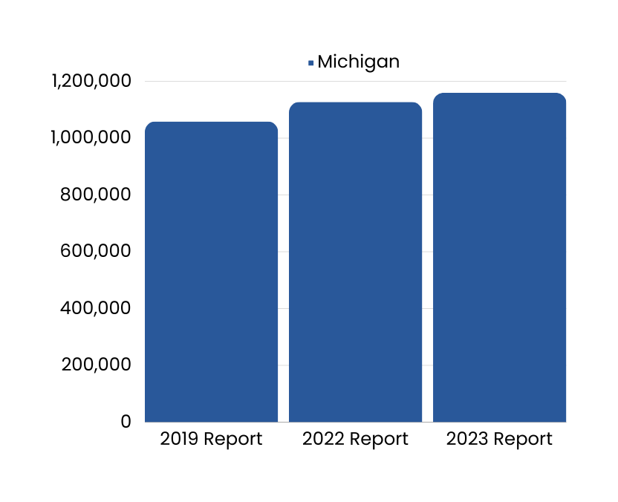
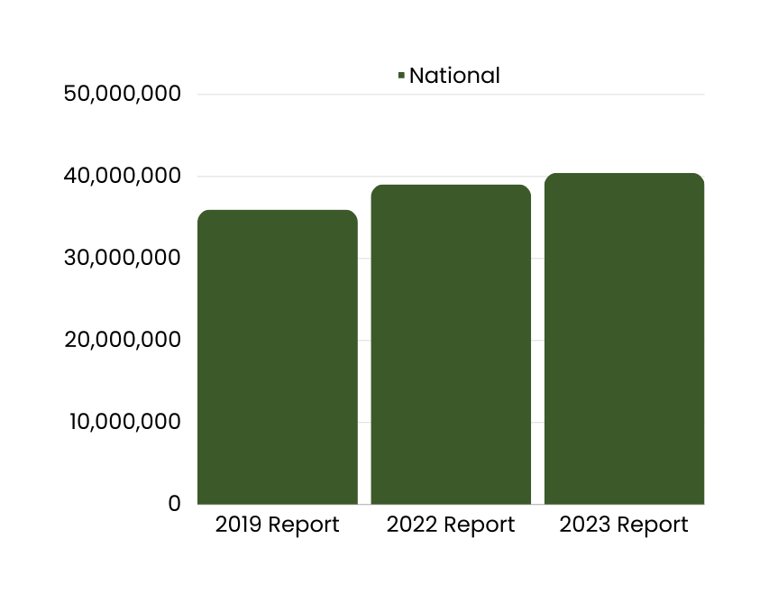
Stop-Outs
As of July 2021, the Some College, No Credential (SCNC) population has reached 40.4 million, up 1.4 million from 39.0 million in the previous year. A lack of re-enrollment and 2.3 million new SCNC students (recent stop-outs) drove this large growth. All 50 states and D.C. experienced growth.
*National Student Clearinghouse Research Center. Some College, No Credential Student Outcomes Annual Report. April 25, 2023.
*source: https://nscresearchcenter.org/some-college-no-credential/
Notes:
https://nscresearchcenter.org/some-college-no-credential/

Slide 17
The Top 10 College and University Advertisers
Among colleges and universities, the top 10 advertisers spent a total of $567 million on advertising in the period between November 2022 and October 2023
Purdue University
$140,992,747
Walden University
$80,452,925
University of Phoenix
$77,039,827
Arizona State Universty
$53,085,992
Southern New Hampshire University
$50,274,947
Capella University
$45,069,630
United Theological Seminary
$36,078,312
PragerU Training Courses
$31,253,029
Western Governors University
$29,672,181
National University
$23,430,475
*source: Vivvix fna Kantar Media Intelligence 11/2022 - 10/2023
Notes:
https://insights.educationdynamics.com/Benchmarks-Report-2024.html?utm_campaign=benchmarks-2024&utm_source=marketo&utm_medium=email&utm_term=banner&utm_content=image

Slide 18
How can we solve the problem?
Michigan's attainment rate is 50.5 percent, and the state is working toward its attainment goal of 60 percent for ages 25-64 by 2030.
*Lumina Foundation
How can we help you reach your goals?

Slide 19
Key Findings
Many adults intend to enroll in postsecondary education, but who intends to enroll looks different than those who are currently enrolled and targeted in traditional enrollment management models.
Regardless of age and level of education, Black and African American and Hispanic and Latinx respondents are more than twice as likely as white respondents to express intent to enroll.
Men of all races and ethnicities are less likely to intend to enroll than women. White men are the population least likely to intend to enroll in education and training.
Parents, those who are single, those who earn less than a family-sustaining wage, and those who are unemployed or don’t have job stability are more likely to intend to enroll in postsecondary education or training.
Most students are interested in taking at least some of their college coursework online and more than half would like to take all of their coursework online.
Intent is a critical indicator of whether a person will go on to enroll in education and training, but theory suggests it may be insufficient to get someone to enroll.
Notes:
Enrollment management efforts often focus on students just out of high school. CollegeAPP survey data shows that 64 percent of Americans between the ages of 18 and 24 plan to enroll. However, according to U.S. Census estimates, only 43 percent of 18- to 24-year-olds are enrolled in education. Older adults are also interested in pursuing more postsecondary education; CollegeAPP survey data show that 42 percent of adults between the ages of 25 and 34 intend to enroll, as well as 29 percent of adults between the ages of 35 and 44. However, just 11 percent of 25- to 34-year-olds and fewer than two percent of those over age 35 are enrolled in college.
Recruiting based on past enrollments will maintain the biases and inequities embedded in the system.
Fourth bullet is what drew me to CollegeAPP. I spent 7 years working with states and institutions of higher ed to improve adult learner success. Strong programs and financial aid efforts ended up going nowhere, because, frankly, no one knew about them . Marketing and outreach efforts to potential students were unsuccessful. This isn’t field of dreams. You’ve got to tell adults about the amazing stadium you’ve build for them. There is a real disconnect among higher ed leaders, faculty, and staff here. More and more, states and institutions are creating programs to support adult learner success and get stop outs back on campus. But, they continue, on the whole, to recruit in the same inefficient manner. CollegeAPP allows for a more efficient, and strategic way to market to and recruit adults to college.

Slide 20
Critical Findings
20%
of all U.S. adults and
36%
of Black, Indigenous, and persons of color over the age of 18 in the U.S.
Intend to enroll in education or training in the next two years.
Many never will, leading to lost potential and widening equity gaps.

Slide 21
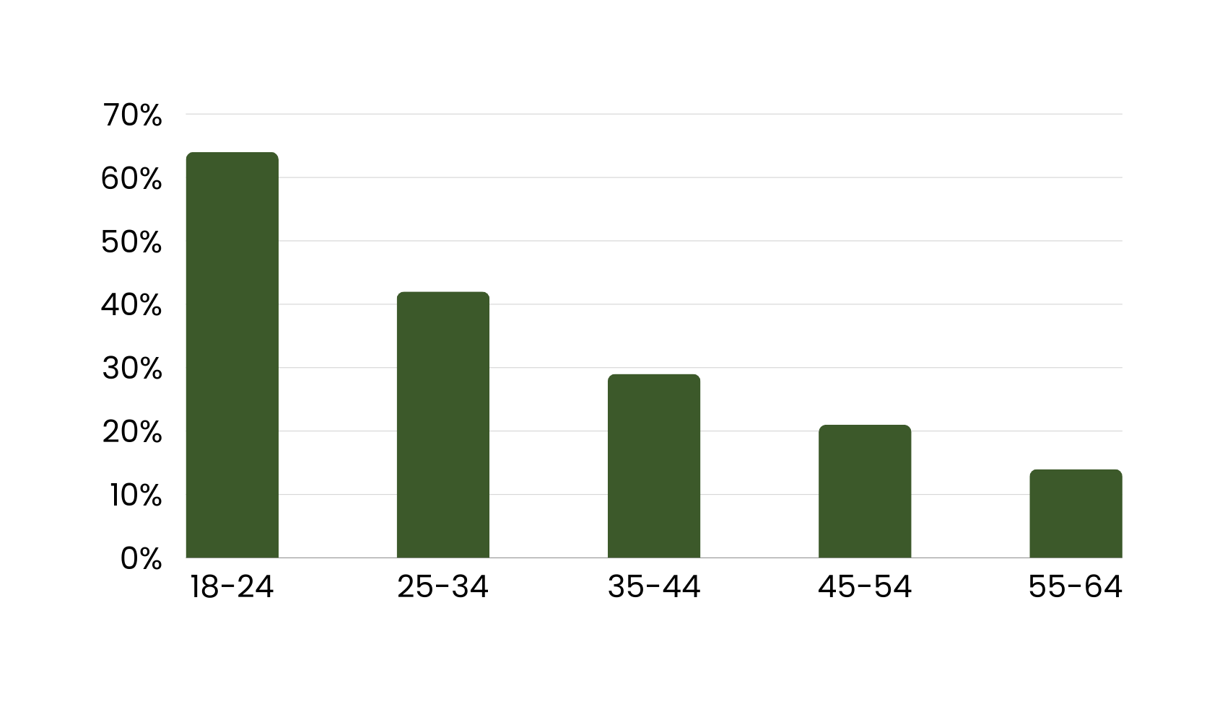
Intent to Enroll By Age
Do you intend to enroll in any education or training programs in the next two years?
Notes:
Enrollment management efforts often focus on students just out of high school. CollegeAPP survey data shows that 64 percent of Americans between the ages of 18 and 24 plan to enroll. However, according to U.S. Census estimates, only 43 percent of 18- to 24-year-olds are enrolled in education. Older adults are also interested in pursuing more postsecondary education; CollegeAPP survey data show that 42 percent of adults between the ages of 25 and 34 intend to enroll, as well as 29 percent of adults between the ages of 35 and 44. However, just 11 percent of 25- to 34-year-olds and fewer than two percent of those over age 35 are enrolled in college.
Recruiting based on past enrollments will maintain the biases and inequities embedded in the system.
Fourth bullet is what drew me to CollegeAPP. I spent 7 years working with states and institutions of higher ed to improve adult learner success. Strong programs and financial aid efforts ended up going nowhere, because, frankly, no one knew about them . Marketing and outreach efforts to potential students were unsuccessful. This isn’t field of dreams. You’ve got to tell adults about the amazing stadium you’ve build for them. There is a real disconnect among higher ed leaders, faculty, and staff here. More and more, states and institutions are creating programs to support adult learner success and get stop outs back on campus. But, they continue, on the whole, to recruit in the same inefficient manner. CollegeAPP allows for a more efficient, and strategic way to market to and recruit adults to college.

Slide 22
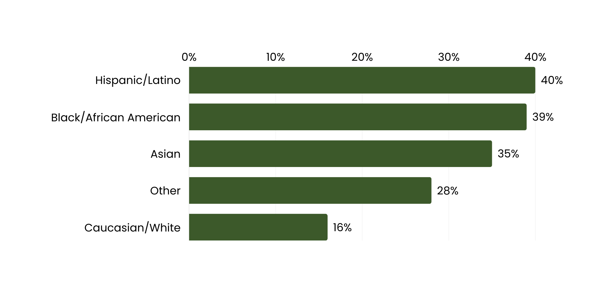
Intent to Enroll By Race/Ethnicity
Do you intend to enroll in any education or training programs in the next two years?
Notes:
Enrollment management efforts often focus on students just out of high school. CollegeAPP survey data shows that 64 percent of Americans between the ages of 18 and 24 plan to enroll. However, according to U.S. Census estimates, only 43 percent of 18- to 24-year-olds are enrolled in education. Older adults are also interested in pursuing more postsecondary education; CollegeAPP survey data show that 42 percent of adults between the ages of 25 and 34 intend to enroll, as well as 29 percent of adults between the ages of 35 and 44. However, just 11 percent of 25- to 34-year-olds and fewer than two percent of those over age 35 are enrolled in college.
Recruiting based on past enrollments will maintain the biases and inequities embedded in the system.
Fourth bullet is what drew me to CollegeAPP. I spent 7 years working with states and institutions of higher ed to improve adult learner success. Strong programs and financial aid efforts ended up going nowhere, because, frankly, no one knew about them . Marketing and outreach efforts to potential students were unsuccessful. This isn’t field of dreams. You’ve got to tell adults about the amazing stadium you’ve build for them. There is a real disconnect among higher ed leaders, faculty, and staff here. More and more, states and institutions are creating programs to support adult learner success and get stop outs back on campus. But, they continue, on the whole, to recruit in the same inefficient manner. CollegeAPP allows for a more efficient, and strategic way to market to and recruit adults to college.

Slide 23
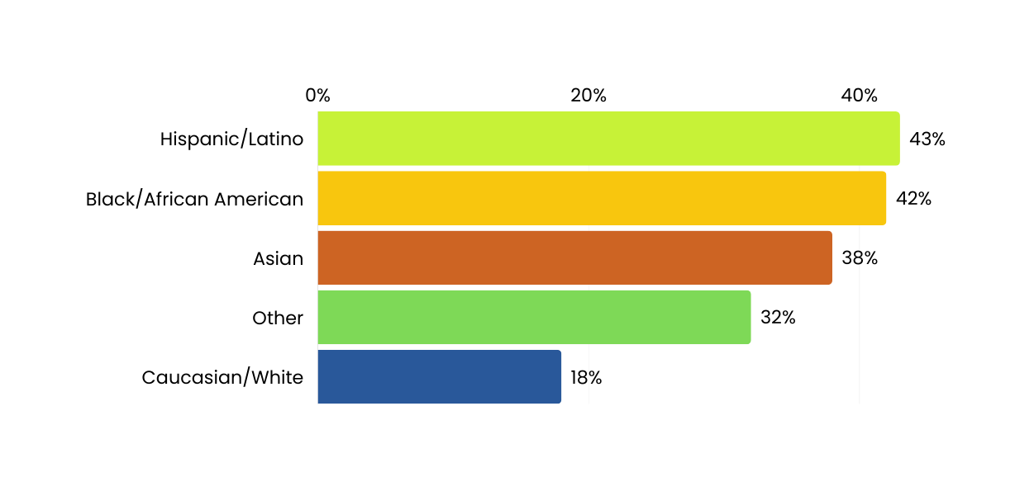
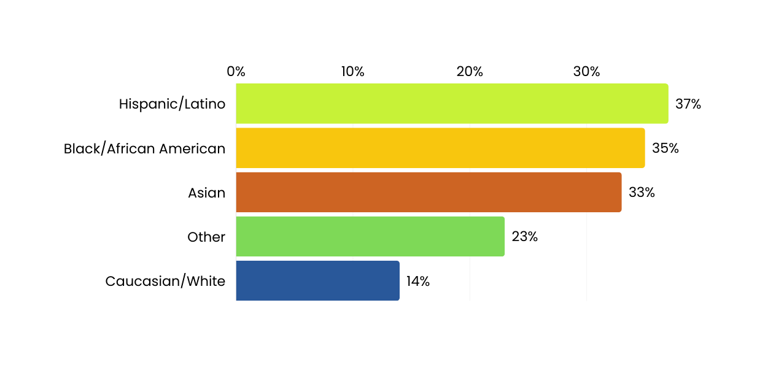
Intent to Enroll By Gender and Race/Ethncity
Do you intend to enroll in any education or training programs in the next two years?
Female
Male
Notes:
Enrollment management efforts often focus on students just out of high school. CollegeAPP survey data shows that 64 percent of Americans between the ages of 18 and 24 plan to enroll. However, according to U.S. Census estimates, only 43 percent of 18- to 24-year-olds are enrolled in education. Older adults are also interested in pursuing more postsecondary education; CollegeAPP survey data show that 42 percent of adults between the ages of 25 and 34 intend to enroll, as well as 29 percent of adults between the ages of 35 and 44. However, just 11 percent of 25- to 34-year-olds and fewer than two percent of those over age 35 are enrolled in college.
Recruiting based on past enrollments will maintain the biases and inequities embedded in the system.
Fourth bullet is what drew me to CollegeAPP. I spent 7 years working with states and institutions of higher ed to improve adult learner success. Strong programs and financial aid efforts ended up going nowhere, because, frankly, no one knew about them . Marketing and outreach efforts to potential students were unsuccessful. This isn’t field of dreams. You’ve got to tell adults about the amazing stadium you’ve build for them. There is a real disconnect among higher ed leaders, faculty, and staff here. More and more, states and institutions are creating programs to support adult learner success and get stop outs back on campus. But, they continue, on the whole, to recruit in the same inefficient manner. CollegeAPP allows for a more efficient, and strategic way to market to and recruit adults to college.

Slide 24
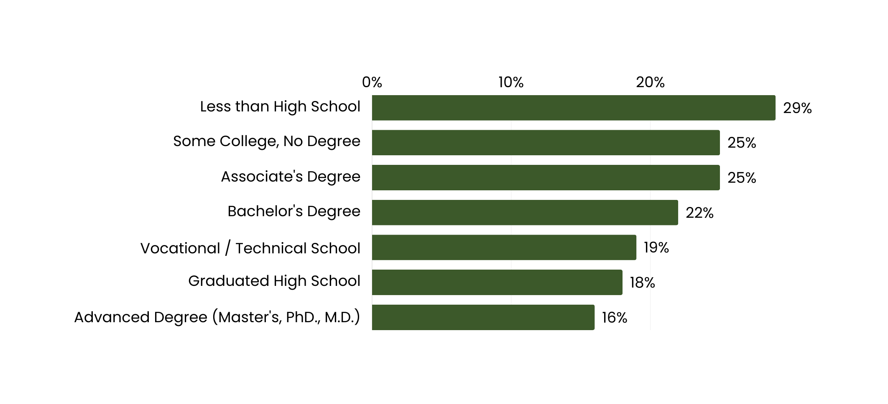
Intent to Enroll By Current Level of Education
Do you intend to enroll in any education or training programs in the next two years?
Notes:
Enrollment management efforts often focus on students just out of high school. CollegeAPP survey data shows that 64 percent of Americans between the ages of 18 and 24 plan to enroll. However, according to U.S. Census estimates, only 43 percent of 18- to 24-year-olds are enrolled in education. Older adults are also interested in pursuing more postsecondary education; CollegeAPP survey data show that 42 percent of adults between the ages of 25 and 34 intend to enroll, as well as 29 percent of adults between the ages of 35 and 44. However, just 11 percent of 25- to 34-year-olds and fewer than two percent of those over age 35 are enrolled in college.
Recruiting based on past enrollments will maintain the biases and inequities embedded in the system.
Fourth bullet is what drew me to CollegeAPP. I spent 7 years working with states and institutions of higher ed to improve adult learner success. Strong programs and financial aid efforts ended up going nowhere, because, frankly, no one knew about them . Marketing and outreach efforts to potential students were unsuccessful. This isn’t field of dreams. You’ve got to tell adults about the amazing stadium you’ve build for them. There is a real disconnect among higher ed leaders, faculty, and staff here. More and more, states and institutions are creating programs to support adult learner success and get stop outs back on campus. But, they continue, on the whole, to recruit in the same inefficient manner. CollegeAPP allows for a more efficient, and strategic way to market to and recruit adults to college.

Slide 25
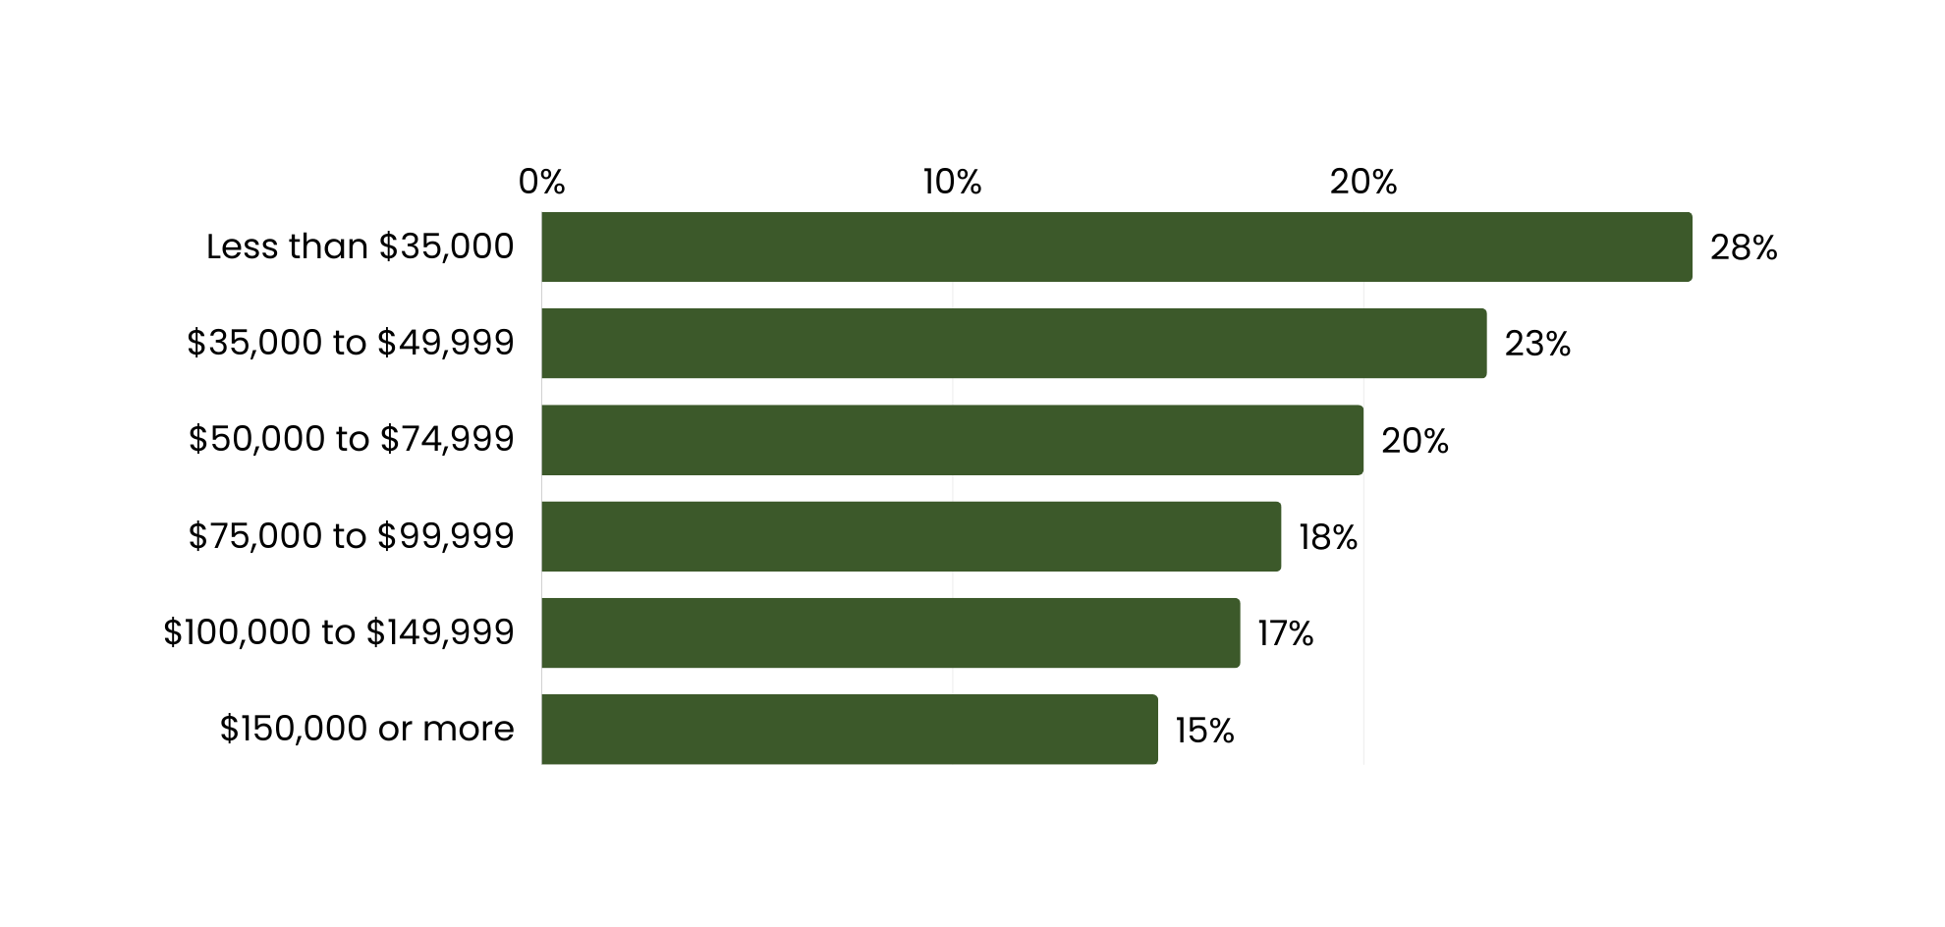
Intent to Enroll For Adults Over 24 By Income
Do you intend to enroll in any education or training programs in the next two years?
Notes:
Enrollment management efforts often focus on students just out of high school. CollegeAPP survey data shows that 64 percent of Americans between the ages of 18 and 24 plan to enroll. However, according to U.S. Census estimates, only 43 percent of 18- to 24-year-olds are enrolled in education. Older adults are also interested in pursuing more postsecondary education; CollegeAPP survey data show that 42 percent of adults between the ages of 25 and 34 intend to enroll, as well as 29 percent of adults between the ages of 35 and 44. However, just 11 percent of 25- to 34-year-olds and fewer than two percent of those over age 35 are enrolled in college.
Recruiting based on past enrollments will maintain the biases and inequities embedded in the system.
Fourth bullet is what drew me to CollegeAPP. I spent 7 years working with states and institutions of higher ed to improve adult learner success. Strong programs and financial aid efforts ended up going nowhere, because, frankly, no one knew about them . Marketing and outreach efforts to potential students were unsuccessful. This isn’t field of dreams. You’ve got to tell adults about the amazing stadium you’ve build for them. There is a real disconnect among higher ed leaders, faculty, and staff here. More and more, states and institutions are creating programs to support adult learner success and get stop outs back on campus. But, they continue, on the whole, to recruit in the same inefficient manner. CollegeAPP allows for a more efficient, and strategic way to market to and recruit adults to college.

Slide 26
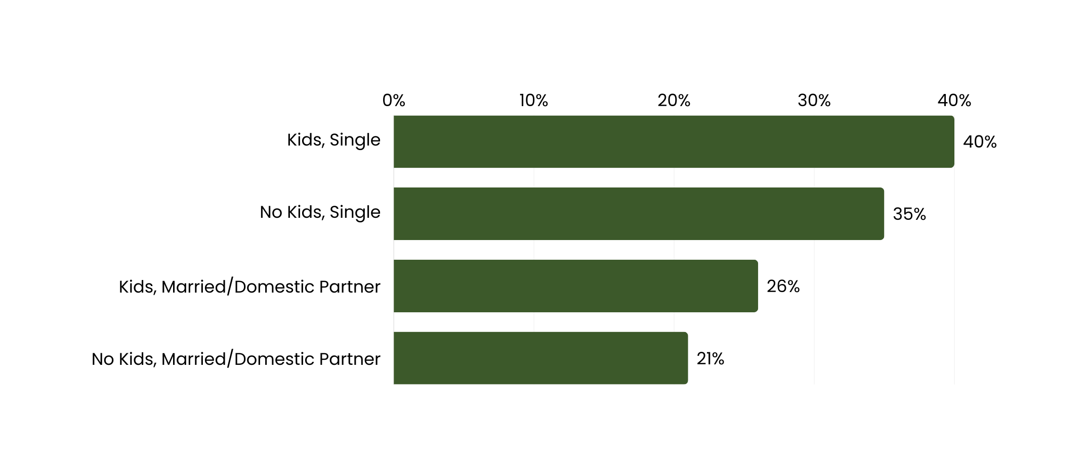
Intent to Enroll For Adults 24-55 By Family Characteristics
Do you intend to enroll in any education or training programs in the next two years?
Notes:
Enrollment management efforts often focus on students just out of high school. CollegeAPP survey data shows that 64 percent of Americans between the ages of 18 and 24 plan to enroll. However, according to U.S. Census estimates, only 43 percent of 18- to 24-year-olds are enrolled in education. Older adults are also interested in pursuing more postsecondary education; CollegeAPP survey data show that 42 percent of adults between the ages of 25 and 34 intend to enroll, as well as 29 percent of adults between the ages of 35 and 44. However, just 11 percent of 25- to 34-year-olds and fewer than two percent of those over age 35 are enrolled in college.
Recruiting based on past enrollments will maintain the biases and inequities embedded in the system.
Fourth bullet is what drew me to CollegeAPP. I spent 7 years working with states and institutions of higher ed to improve adult learner success. Strong programs and financial aid efforts ended up going nowhere, because, frankly, no one knew about them . Marketing and outreach efforts to potential students were unsuccessful. This isn’t field of dreams. You’ve got to tell adults about the amazing stadium you’ve build for them. There is a real disconnect among higher ed leaders, faculty, and staff here. More and more, states and institutions are creating programs to support adult learner success and get stop outs back on campus. But, they continue, on the whole, to recruit in the same inefficient manner. CollegeAPP allows for a more efficient, and strategic way to market to and recruit adults to college.

Slide 27
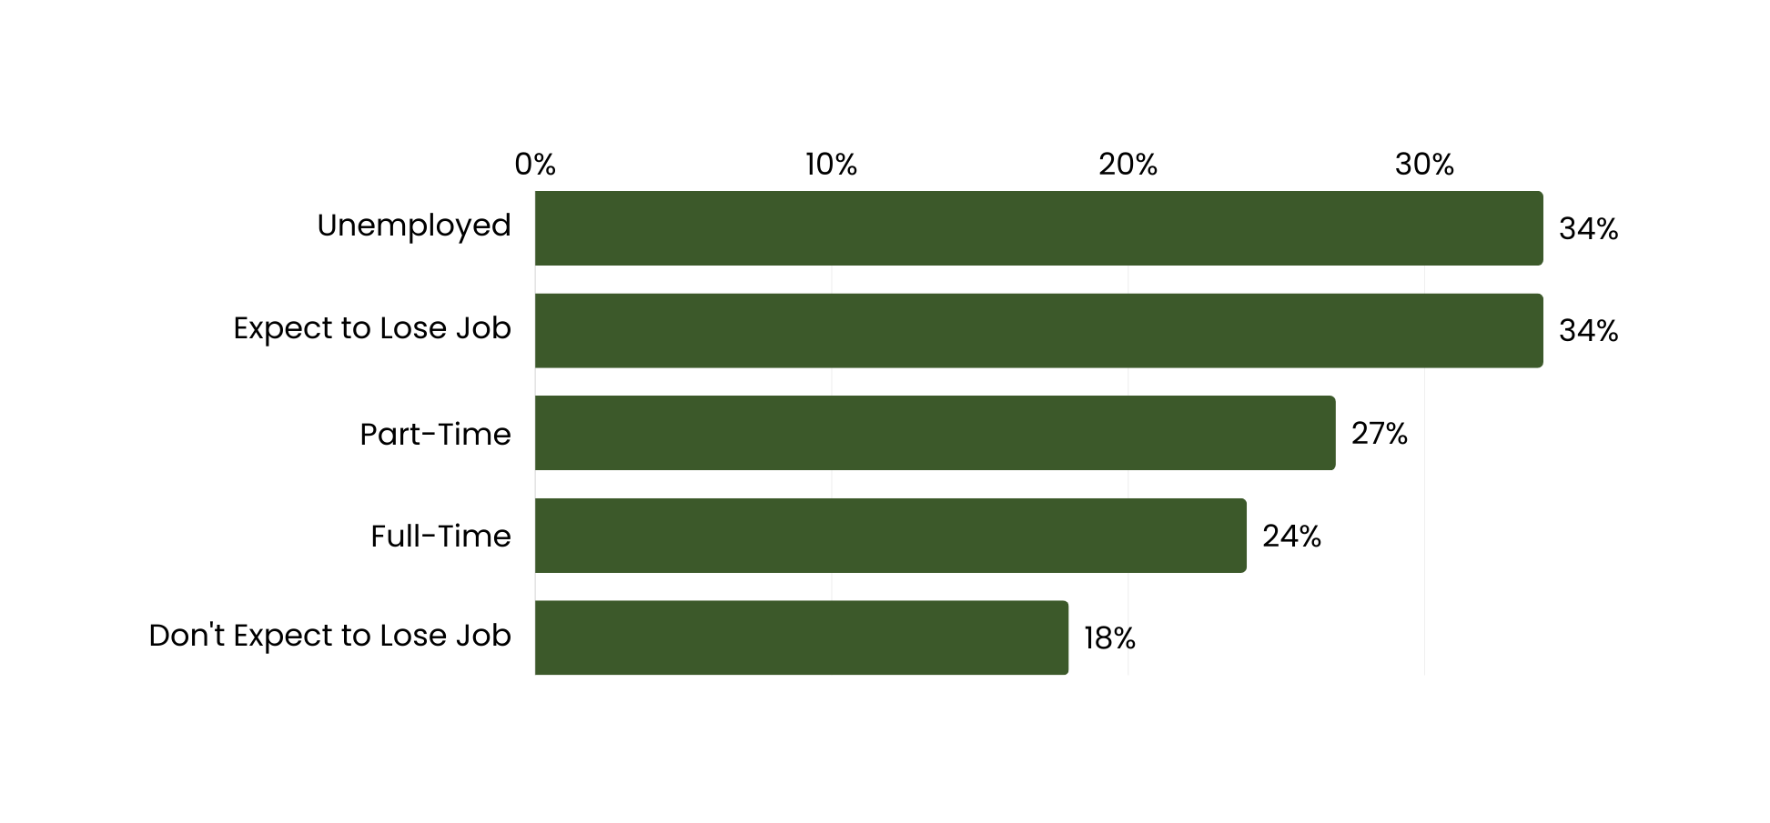
Intent to Enroll By Employment Status and Job Security
Do you intend to enroll in any education or training programs in the next two years?
Notes:
Enrollment management efforts often focus on students just out of high school. CollegeAPP survey data shows that 64 percent of Americans between the ages of 18 and 24 plan to enroll. However, according to U.S. Census estimates, only 43 percent of 18- to 24-year-olds are enrolled in education. Older adults are also interested in pursuing more postsecondary education; CollegeAPP survey data show that 42 percent of adults between the ages of 25 and 34 intend to enroll, as well as 29 percent of adults between the ages of 35 and 44. However, just 11 percent of 25- to 34-year-olds and fewer than two percent of those over age 35 are enrolled in college.
Recruiting based on past enrollments will maintain the biases and inequities embedded in the system.
Fourth bullet is what drew me to CollegeAPP. I spent 7 years working with states and institutions of higher ed to improve adult learner success. Strong programs and financial aid efforts ended up going nowhere, because, frankly, no one knew about them . Marketing and outreach efforts to potential students were unsuccessful. This isn’t field of dreams. You’ve got to tell adults about the amazing stadium you’ve build for them. There is a real disconnect among higher ed leaders, faculty, and staff here. More and more, states and institutions are creating programs to support adult learner success and get stop outs back on campus. But, they continue, on the whole, to recruit in the same inefficient manner. CollegeAPP allows for a more efficient, and strategic way to market to and recruit adults to college.

Slide 28
CollegeAPP Overview
Notes:
https://www.wiche.edu/resources/knocking-at-the-college-door-10th-edition/

Slide 29
CollegeAPP introduced person-level modeling to higher education
2008
2013
2019
Presidential campaigns create the first person-level marketing campaigns based on survey research, predictive models, machine learning and digital outreach
Analytics and database firms launch commercial applications bringing techniques to CPG, entertainment, automotive, retail, telecom
CollegeAPP launches to predict the probability an adult intends to seek education or training.

Slide 30
The CollegeAPP Process
1. Conduct Large Sample Survey
2. Build Models & Score Files
3. Create Pipelines
4. Activate Campaigns
Survey sample pre-matched to national and state consumer databases
Data scientists create and test predictive models and apply them to individuals in the database
Create highly refined target audiences based on future Intent to Enroll
Activate outreach campaigns and build communication channels with prospective adult students
Predictive Analytics
Marketing
Services

Slide 31
Personal Level Data on 243+ million adults
Data fields include:
Detailed person-level demographics
Home address
Phone number
Children in household
Household finances
(over 500+ data fields for each person)
CollegeAPP Models:
Intent to Enroll
Institutional Preference
Instructional Modality Preference
Job Seeking Intent
Education Attainment

Slide 32
Michigan: Using the CollegeAPP Models
Total Number of Adults: 9,430,192
Number of Adults with Intent to Enroll in the next two years: 2,375,879
Interested in attending a university or 4-year school: 833,976
Interested in attending a community college:
619,795
Interested in Hybrid Education:
2,129,649
Interested in Online Education:
2,235,416
Intend to seek a new job in the next year:
2,502,520
Notes:
All scores at 55

Slide 33
Marketing Best Practices
Notes:
https://www.wiche.edu/resources/knocking-at-the-college-door-10th-edition/

Slide 34
Best Practices: Using CollegeAPP Data
Media Placement
SMS/Texting
Provides the highest ROI for our clients
Upload CollegeAPP audiences to Facebook/Instagram (Meta) and LinkedIn
We don't typically recommend using this approach as a first point of contact. However, nurturing your funnel through SMS is a terrific way to increase your conversion rates.
Direct Mail
Email
Export lists ready for a mail house
Using our person-level models in combination with other filters, such as primary language, reduces mail costs by targeting only people with high probability of intent to enroll.
We do not recommend email as a first point of contact. Emails are the most volatile data point in our database.
Emails can be requested for an additional cost due to a 4-stage email validation process to protect your email reputation.
Programmatic
Segments are matched to individuals and households. This allows us to target for use in display, video, native, streaming audio, and OTT/CTV advertising, among others.

Slide 35
Establishing a Niche
What do we do better than other schools?
What do we have that they don’t?
Put that in the context of what adults are looking for.

Slide 36
Integrated Marketing Communications
Social Media
Multi-Media
Email Marketing
Print Media & Direct Media
Search
Website
Social Share
Video
Other Offline Media
Public Relations
Blogs
Mobile
https://njmnmims.medium.com/integrated-marketing-communication-fc42fcefaebe

Slide 37
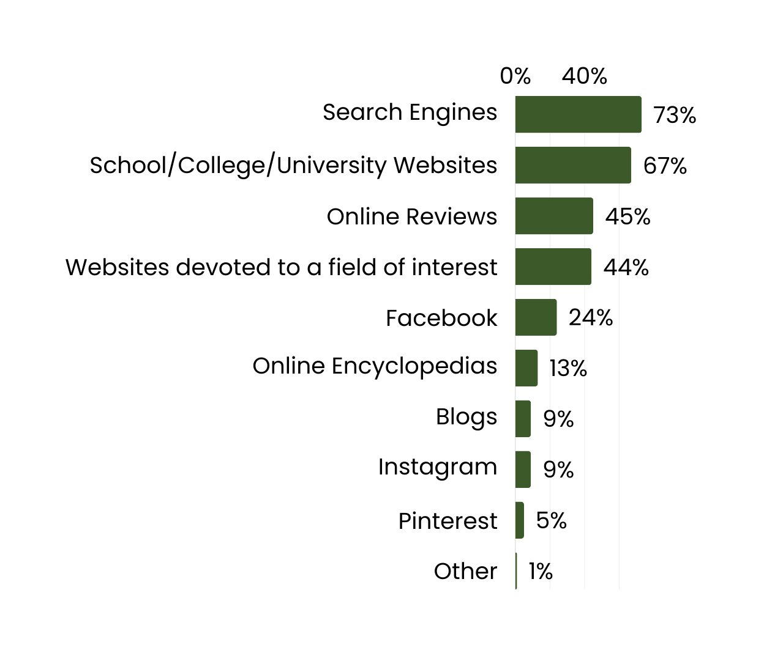
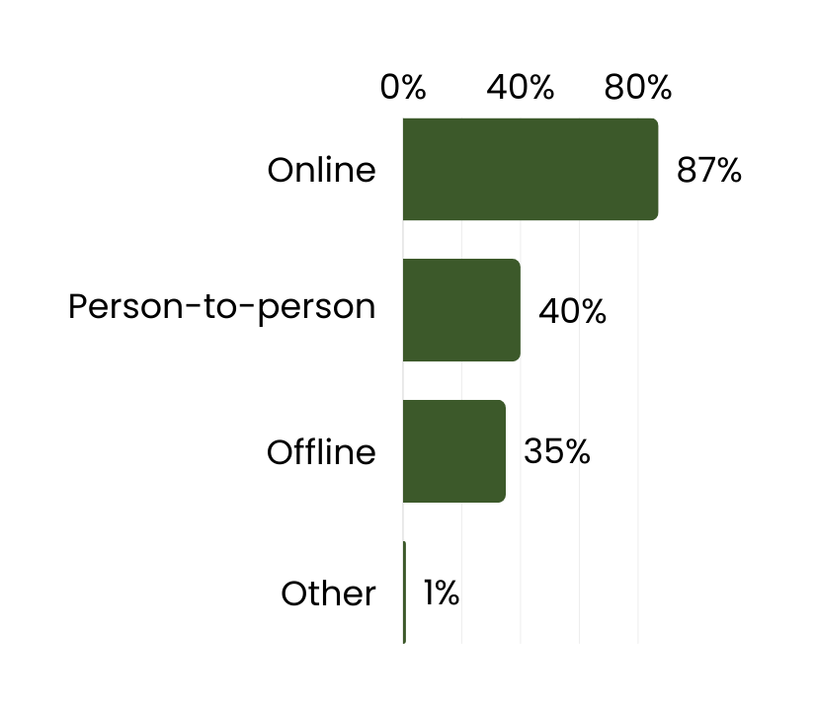
How Do Adult Learners Find Us?
e.g., social media, etc.
e.g., campus visits friend recommendations, etc.
e.g., print, television, etc.

Slide 38
Best Practices: Lead Nurturing
Follow-up immediately
Keep the momentum by responding as quickly as possible - as soon as 5 minutes but no more than 24 hours.
Provide Relevant Information
Answer any questions the prospective student asked and offer additional information like program-specific details, cost, deadlines, etc.
Add Value
Each follow-up communication should have value-added information. Provide more helpful links, videos, and resources rather than solely an ‘Apply Now’ call to action.
Source: https://www.insidehighered.com/blogs/call-action-marketing-and-communications-higher-education/following-leads-higher-ed

Slide 39
Case Studies
Notes:
https://www.wiche.edu/resources/knocking-at-the-college-door-10th-edition/

Slide 40
Case Study: Community College
Part of the SUNY System, Dutchess Community College offers access to a broad range of learning opportunities and experiences to meet the educational needs of a diverse community.
Problem
Solution
Dutchess Community College recently opened a state-of-the-art mechatronics facility in which they offer multiple job-ready certifications. Their goal was to cost-effectively recruit adult and non-traditional learners into the new programs.
CollegeAPP selected marketing audiences using proprietary Intent to Enroll probability scores combined with CollegeAPP+ occupation data to finely tune audiences for the specialized programs offered at the lab.
CollegeAPP’s Media Placement and Optimization team managed the campaign.

Slide 41
Case Study: Community College
Channel + Creative
CollegeAPP placed and managed two campaigns on the Meta platform. The first was a video campaign and the second was a “carousel” ad offering multiple options for adults to self-select their interests.

Slide 42
Case Study: Community College
The Results
The Dutchess campaign is driving high engagement with adults in their service area. More than five thousand adults have clicked on the ads on $4,900 media spend.
SUNY
Dutchess
Industry
Benchmark
Cost Per Click
$0.75
$1.06*
Top Line Results:
76,676 Total Reach (Audience Size)
6,520 Total Clicks
5,130 Unique Link Clicks
SUNY
Dutchess
Engagement Rate
6.70%
*source: https://instapage.com/blog/facebook-advertising-benchmarks

Slide 43
Case Study: University / College
Founded in 1824, Rensselaer Polytechnic Institute is America’s first technological research university. Rensselaer encompasses five schools, over 30 research centers, more than 140 academic programs .
Background
Solution
RPI retained CollegeAPP to advertise MBA and Graduate Engineering programs nationally. The campaigns include both brand and call-toaction creative on multiple digital and social channels. The campaigns include recruitment to targeted in-person event across the country using CollegeAPP+ occupation data.
CollegeAPP placed video ads to a national audience with geographic specificity. Audiences were selected by their Intent to Enroll scores as well as CollegeAPP+ occupation data. Campaigns were served on the Meta and LinkedIn platforms.

Slide 44
Case Study: University / College
The Results
RPI’s campaigns achieve a 56%* reduction in cost-per- lead compared to industry average, while generating targeted brand and program awareness with prospects at certain employers in selected cities and regions across the country
Total Reach: 6,081,045
Unique Link Clicks: 254,336
6.70%
Engagement Rate: 4.18%
Cost Per Click: $0.53
Number of Leads: 449
Cost per Lead: $556.79
Industry Average CPL: $1,262
*Total Cost Per Lead / Industry Average

Slide 46
The Enrollment Cliff
Number of 18 Year Olds
Source: https://www.cupahr.org/issue/dept/interactive-enrollment-cliff/

Slide 47
Sarah Szurpicki, Director
Michigan Office of Sixty by 30

Slide 48
Breakout Sessions

Slide 49
Breakout Sessions
1:10-2:10 pm Session:
Power Mapping (60 min) in Multi-room CDEF
Glen Oaks CC, U of Olivet, Ferris State, Alpena CC, Grand Valley State, Central MI U, Muskegon CC
College APP Service Area (1st 25 min then switch) in Room 201 & 202
Bay Coll, Northern MI U, Jackson Coll
Labor Market Info (1st 25 min then switch) in Room 203
Western MI U, Kalamazoo CC, Kalamazoo Promise, Mott CC, Lansing CC
2:20-3:20 pm Session:
Power Mapping (60 min) in Multi-room CDEF
Bay Coll, Northern MI U, Jackson Coll, Western MI U, Kalamazoo CC, Kalamazoo Promise, Mott CC, Lansing CC
College APP Service Area (1st 25 min then switch) in Room 201 & 202
Glen Oaks CC, U of Olivet, Ferris State, Alpena CC,
Labor Market Info (1st 25 min then switch) in Room 203
Grand Valley State, Central MI U, Muskegon CC
MI-RAISE Design Lab

Slide 50
Next Steps
Share your feedback via the Exit Survey (QR code)
Complete your travel reimbursement documentation
Schedule your January design sprint kick-off and February coaching sessions with Sova
Hold February 13th 12n-1:30pm for virtual convening and March 21st 10am-3:30pm for in-person convening for your team (you should have calendar invites)
MI-RAISE Design Lab
Notes:
Jeremy
AK suggested talking points for Jeremy:
Following this meeting, possibly in your inbox right now, you’ll find a sign up sheet for your initial self-assessment reflection session that we’re asking each of your teams to participate in before the end of the year. At that meeting you’ll also be asked to schedule your design sprint kick-off with Sova in January, so please come to that meeting with your team’s January availability.
And finally, please be sure to mark your calendars for the virtual convening on December 12 and the in-person meeting January 17

Slide 51
Q & A
Contact us:
TheCenter@talentfirst.net
.
Notes:
Jeremy
We’re happy to answer questions now and, should you have questions following this meeting, feel free to reach out and we’ll make sure to direct your question to the right person.

