Slide 1
Michigan Regional Adult Initiative
for Skills and Education (MI-RAISE) Design Lab
Kick-off Session
November 14, 2023
Notes:
Jeremy
AK suggested talking points for Jeremy’s opening
-Please go to the upper right corner of your pic or to your name on the participant list and rename yourself to include your institution
-Please also introduce yourself in the chat -- share where you’re from, your role, and, if you’d like, something about your institution that lets your colleagues hear learn something about your context.
-We’re going to dive in and make good use of your time today. We’re going to give you a little background and voiceover on where this work comes from and why we’re approaching it this way. We’ll provide an overview of the process and timeline, you’ll get to meet the -project partners, and we’ll share next steps.
-We’re excited that you’re here, and we’re looking forward to diving in.
-

Slide 2
Welcome!
Funding for MI-RAISE Design Lab being provided by:

Slide 3
Agenda
Welcome and Introductions
Goal of the MI-RAISE Design Lab
Process & Timeline
Next Steps
Q&A
MI-RAISE Design Lab
Notes:
Jeremy
-------
AK suggested talking points for Jeremy’s opening
Goal of the MI-RAISE Design Lab
--The goal of this 6 month process is to help you and your colleagues build strong, strategic, actionable plans for significantly enhancing and improving your ability to serve adult learners.
In the near future, starting with but not limited to, the first round of IIA grants, resources will be made available to support institutional capacity for more effectively meeting the needs of adult learners. To be competitive for these resources, institutions and partnerships will need to demonstrate that they have undertaken a careful, planful process in developing proposals. The MI-RAISE Design Lab has been designed to provide a light, but structured process for building out strong project plans.
--The reason we’re taking this approach is because we know from listening to you in a variety of settings that 1) you need resources to do important work, 2) you don’t have a lot of time to think strategically, because you’re so busy working every day on the huge array of responsibilities you have, 3) it’s far too easy to work in silos and miss those opportunities to connect across areas in creative ways that can positively impact your students’ experiences, and 4) for most of you, even if it’s in your institutional bones, effectively meeting the diverse needs of today’s adult learners is hard work that requires next-level strategy and coordination.

Slide 4
“Innovation is hard at first, clumsy in the middle, but incredible at the end."
~Sravani Saha Nakhro, Physician and Humanitarian

Slide 5
MI-RAISE Design Lab Key Partners
Michigan Center for Adult College Success - Project lead
Education Strategy Group - Technical assistance, labor market data, convening support
Sova - Design process lead, coaching, technical assistance
CollegeAPP - Adult Prospect Pipeline data mining and modeling
TalentFirst - Landscape analysis and Labor market data
MI-RAISE Design Lab
Notes:
Jeremy
AK suggested talking points for Jeremy (and, yep, take ‘em or leave ‘em -- and ESG pls approve how you’re described)
We have a great group of partners here that are going to be working together behind the scenes and with you in a coordinated way to provide you with the information, ideas, and support you need to build strong, grounded proposals. The Center is the lead and we’re excited to be in this work (insert ½ a sentence on the Center’s origin and charge).
Education Strategy Group, through a Kresge Foundation grant, is bringing their expertise to provide grounding for the Design Lab participants, to help produce labor market data for participating institutions, and to provide convening support and network learning opportunities. They have created a self-assessment tool that you’ll be provided with and around which you’ll have one 60-90 minute grounding session before the end of the year. Our ESG colleagues will tell you more about that in a moment, but know that the self-assessment discussion will not be an onerous process, but a discussion. You’ll have the opportunity to prepare for the session, but no preparation will be required.
Sova is the design process lead and their team will be working individually with your institutions to tailor a process that will result in compelling, strategic, actionable, grounded proposals for the IIA. In a couple of minutes here, you’ll hear about Sova’s approach to this work, but know that Sova is committed to meeting you where you are and tailoring a process that feels light, fits within the realities of your team’s busy lives, and that helps you build the strongest possible proposals by May.
CollegeAPP will be providing Adult Prospect Pipeline data mining and modeling to help you think strategically and broadly about the opportunities you have in your service region. Additional data analysis of this kind will be helpful to you in the work of building strong, grounded proposals.
TalentFirst will be working with ESG and CollegeAPP to extend our collective capacity to provide you with good information about the broader landscape that your institutions are operating in and the labor market opportunities that exist in your service region.
While the support has been assembled specifically for the purpose of readying institutions to apply for IIA and other grants, we think the insights and support provided by the partners will be of wider benefit to you and your colleagues.

Slide 6
The MI-RAISE Design Lab Cohort
Jackson College
Lead: Jamie Vandenburgh, Asst Dean of Instruction
Partner(s): (TBA)
Team:
Kurt Linberg, VP of Higher Education Consulting
Justin Gaeta, Dir of Institutional Research and Effectiveness
Jennifer Mikesall, Dir Library Services
Ashley Van Heest, Exec Dir of Student Success and Retention
Muskegon Community College
Lead: Kelley Conrad, Provost & Chief Student Services Officer
Partner(s): (n/a)
Team:
Patti D'Avignon, Dean of Student Services
Dan Rinsema-Sybenga, Dean of Academic Affairs
Erin Strauts, Dir of Institutional Effectiveness

Slide 7
The MI-RAISE Design Lab Cohort
Lansing Community College
Lead: Ronda Miller, Dean of Student Affairs
Partner(s): (n/a)
Team:
Monet Lewis, Assoc Dean Center for Academic and Career Pathways
Andrea Hoagland, Dean of Arts and Sciences
Bay de Noc Community College
Lead: Cindy Gallagher, VP of Business, Technology, Allied Health and Workforce Training
Partner(s): (n/a)
Team:
Travis Blume, VP of Student Services
Amy Reddinger, VP of Arts and Sciences, Diversity, Equity and Belonging
Jason Sullivan, Exec Dir West Campus
Penny Pavlat, Dir of Institutional Research and Reporting

Slide 8
The MI-RAISE Design Lab Cohort
Western Michigan University
Lead: Jason Glass, Assoc VP Teaching and Learning
Partner(s): Kalamazoo Valley Community College and Kalamazoo Promise
Team:
Tracy Labadie, Assoc VP for Collaboration, Compliance, and Analytics (Kalamazoo Valley Community College)
Von Washington, Jr., Exec Dir of Community Relations (Kalamazoo Promise)
Glen Oaks Community College
Lead: Adam Cloutier, VP of Academics
Partner(s): University of Olivet
Team:
Tonya Howden, VP of Student Services (Glenn Oaks CC)
Karen Chaney, Assoc Provost & Academic Dean (U of Olivet)
KayDee Perry, Assoc Provost for Student Development (U of Olivet)
Meredith Dobson, Special Asst for Academic Innovation and Development (U of Olivet)

Slide 9
The MI-RAISE Design Lab Cohort
Central Michigan University
Lead: Kaleb Patrick, Assoc VP, Innovation and Online
Partner(s): (n/a)
Team:
Nel Boose, Exec Dir, Business Operations
Darcie Wilson, Exec Dir, Portfolio Management
Casie Hansel, Regional Dir, Business and Community Engagement
Katie Bollman, Dir, Online Student Services
Alpena Community College
Lead: Paige Gordier, VP of Instruction
Partner(s): (n/a)
Team:
Nancy Sequin, Dean of Students
Dawn Stone, Dean of Workforce Development
Mike Kollien, Dir of Admissions
Lisa Snyder, Exec Dir of the Office of Information Technology
Todd Wozniak, Student Success Center

Slide 10
The MI-RAISE Design Lab Cohort
Ferris State University
Lead: Steve Reifert, Assoc Provost & Dean of Extended and International Operations
Partner(s): (n/a)
Team:
Deedee Stakley, Dir, Office of Transfer and Secondary School Partnerships
Todd Stanislav, Dir, Faculty Center for Teaching and Learning
Cindy Smith, Educational Counselor Assoc Professor
Michael Zaborowski, Dir of Academic Advising
Angela Roman, Dir of CAPS
Matthew Smith, Dir of Online Development
Kasey Thompson, Special Asst for Academic Innovation and Entrepreneurship
Mott Community College
Lead: Jason Wilson, VP Student Academic Success
Partner(s): (n/a)
Team:
Robert Mathews, Assoc VP, Workforce & Economic Development
Kevin Asman, Asst VP Academic Affairs
Rebecca Myszenski, Asst VP Career & Technical Education
Marcus Mathews, Asst VP Workforce & Economic Development
Drew Thiemann, Exec Dir of Institutional Research & Decision Support
Michelle Nelson, Asst VP Student Success Services
Zena Williams, Exec Dir of Financial Aid

Slide 11
The MI-RAISE Design Lab Cohort
Grand Valley State University
Lead: Kara Van Dam, Vice Provost, Graduate & Lifetime Learning
Partner(s): (n/a)
Team:
Kate Vanderkolk, Dir of Prior Learning Assessment and Adult Learning Programs
Lucas Treadwell, Dir of Continuing and Workforce Education
Northern Michigan University
Lead: Steve VandenAvond, Assoc Provost for Extended Learning and Community Engagements
Partner(s): (n/a)
Team:
Brad Hamel, Exec Dir Global Campus
Stephanie Zadroga-Langlois, Dir, Continuing Education and Workforce Development
Carly Harrington, Assoc Dir of Academic Support Services, Global Campus
Josh Santiago, Registrar

Slide 12
Goal of the MI-RAISE Design Lab
Goal: To prepare post-secondary institutions to strategically utilize state grants and other potential funding opportunities.
Why?
Supporting Michigan’s Sixty by 30 goal by increasing the number of adults obtaining postsecondary credentials.
Maximize impact of state grants, Center grants, and other funding opportunities.
Responsive to concerns that institutions are seeking additional design and planning supports.
Talent is everywhere, Opportunity is not. Let’s create more opportunities.
We’re also committed to learning from and evaluating this process
MI-RAISE Design Lab
Notes:
Jeremy
AK suggested talking points for Jeremy (take ‘em or leave ‘em)
Goal of the MI-RAISE Design Lab
--The goal of this 6 month process is to help you and your colleagues build strong, strategic, actionable plans for significantly enhancing and improving your ability to serve adult learners.
-In the near future, starting with but not limited to, the first round of IIA grants, resources will be made available to support institutional capacity for more effectively meeting the needs of adult learners. To be competitive for these resources, institutions and partnerships will need to demonstrate that they have undertaken a careful, planful process in developing proposals. The MI-RAISE Design Lab has been designed to provide a light, but structured process for building out strong project plans.
--The reason we’re taking this approach is because we know from listening to you in a variety of settings that 1) you need resources to do important work, 2) you don’t have a lot of opportunities/time to think strategically, because you’re so busy working every day on the huge array of responsibilities you have, 3) it’s far too easy to work in silos and miss those opportunities to connect across areas in creative ways that can positively impact your students’ experiences or to build or strengthen the partnerships that can lead to the gains for students we all want to see and 4) for most of you, even if it’s in your institutional bones, effectively meeting the diverse needs of today’s adult learners and creating real opportunity for adult learners to thrive is hard work that requires next-level strategy and coordination. We designed this process with all this in mind.
---Evaluation will be a part of this because we want to learn from you about how this process goes and get insights for improving

Slide 13
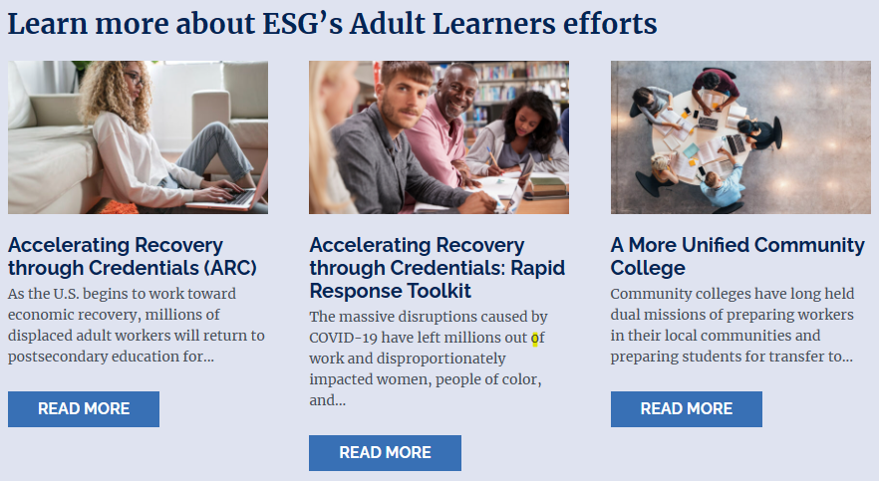
Adult Learners
Who do we mean by “adult”? Individuals with high school diploma or equivalency and are one year or more removed high school and, for data purposes, usually use 25 and older
Why focus on adults?
49.5% of MI adults lack a post-secondary credential
Skilled talent is needed now
Postsecondary credentials drive economic mobility, improve individual well-being, and strengthen community prosperity.
High school graduating class size continues to decline
Notes:
Jeremy & Christine
Jeremy Starts & Talks about Michigan
Adult learner: individuals with high school diploma or equivalency and are one year or more removed high school ( this aligns with MI Reconnect); for data purposes, usually use 25 and older
49.5% of MI adults lack a post-secondary credential
Our state must develop its talent
Postsecondary credentials drive economic mobility by opening the door to higher-paying jobs, allowing more Michiganders to build better lives for themselves and their families
High school graduating class size has fallen by nearly 10% over a decade
--In September 2023, the Center released a landscape analysis , “Adult Postsecondary Education in Michigan and Beyond,” and if you check out that report or the executive summary you’ll see how the Center is thinking about the landscape in which your institutions are operating. As you get going in this process, we encourage you to share the landscape analysis with your team and use it as a grounding resource for your planning. (If a screenshot of the landscape analysis doesn’t sit along a screenshot of an ESG report on adult learners on anther slide, maybe it could go on this slide to provide visual interest and direct people to the landscape as a grounding resource)
Christine Picks Up to Talk About ESG and Segue to the Self Assessment
ESG is excited to be a part of this work in Michigan, and we invite you to check out the resources and reports we’ve created to help institutions, systems, and leaders in the hard work of meeting the needs and expectations of adult learners.

Slide 14
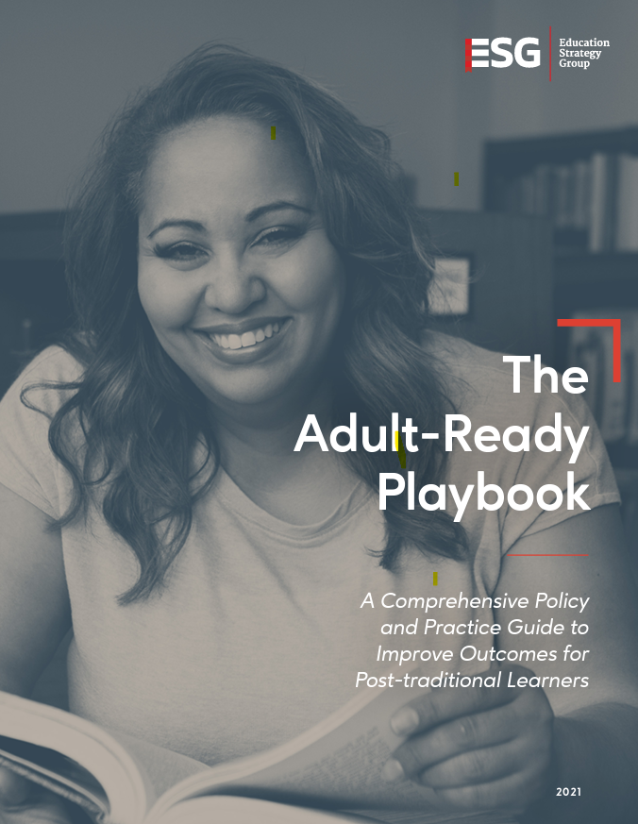
MI-RAISE Design Lab Process
Data Provided:
Labor Market Supply-Demand Analysis
Prospective Learner Data Mining
Self-Assessment Process:
Each team member will complete the self-assessment individually before the reflection session.
Each institution/partnership will participate in a 60-90 minute reflection session anchored by resources created for the field by ESG.
Be on the lookout for an email to schedule your reflection session before December 20
Notes:
Christine/Disraelly

Slide 15
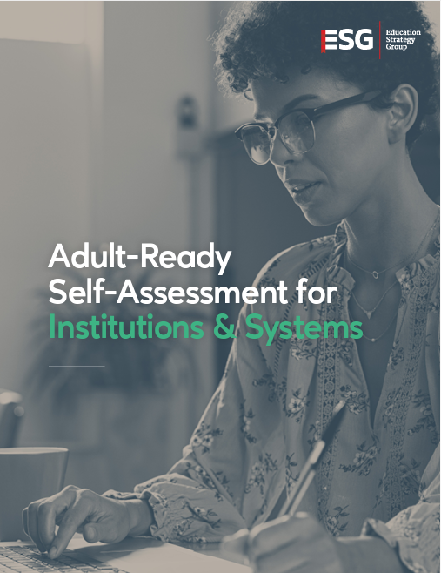
Self-Assessment Preview
Response options
I am not familiar with this topic:
This subject matter is unfamiliar to you, and you are not acquainted with the details necessary to provide a response.
This is not a priority:
This action is not being implemented at the institutional level and there is little interest in doing so.
This is not yet a priority and is worth considering:
This action is not being implemented, but may be in the future.
This is a priority and we plan to implement it:
Our institution is engaging in planning to effectively implement this strategy.
This is a priority with work underway, but not at scale:
This action is being implemented, but not to all learners who would benefit from it.
This is a priority and is implemented at scale:
This action is being effectively applied to all learners who would benefit from it.
Self-Assessment
Notes:
Christine/Disraelly

Slide 16
MI-RAISE Design Lab Process: December - March Workshops
Education Strategy Group and CollegeAPP will provide content workshops to help institutions understand who adult learners are, how to identify/recruit them, and what are best practices to support them:
December - Understanding and Supporting Adult Learners
January - Recruiting Adult Learners
February - Seamless Pathways that Accelerate
March - Holistic Supports
MI-RAISE Design Lab
Notes:
Christine

Slide 17
MI-RAISE Design Lab Process: January - May Design Sprint
Sova will provide tailored support to help each participating institution partnership take the steps necessary to create strong, fundable proposals:
January - Data Sensemaking & Asset Mapping
February - Prioritization & Partnerships
March - Theory of Change & Action
April - Milestones & Metrics, Implementation Planning
May - Innovation Investment Award Proposals Due Early May
MI-RAISE Design Lab
Notes:
Alison
Talking Points
We’ll be working with you to create the right cadence of engagement for your team. We’ll meet you where you are and fit the process around your realities. Sova doesn’t do ‘make work’ so you won’t be asked to fill out templates or complete electronic paperwork to show you’re engaged. Instead, we’ll work with your team to find the right ways to engage and support you in developing strong proposals. We know that strong, fundable proposals must include certain elements and we’ll help create the conditions for you to ask and answer the key questions. This timeline is an example, not a pre-baked plan, and we’ll be looking to help you build on your strengths and create new opportunities.
The Sova team is going to bring a wealth of experience and knowledge to the work, but we’ll also be on hand to curate additional TA as needed -- if your team needs an hour with an expert on a specific topic that is outside of our expertise, we’ll find that expert and get you set up with them. We’ll be liaising regularly with the rest of the project team so that in addition to tapping Sova’s extensive network of knowledgeable practitioners, we’ll be able to tap into ESG’s and the other project partners’ networks to get you the insights and support you need to build strong proposals.
Someone from the Sova team will join the initial self-assessment reflection conversation that you’ll each be involved in before the end of the year, and at the end of that session we’ll ask you to schedule a touchpoint with us during the first half of January. We’ll go from there.
COACH BIOS AS NEEDED
Alison Kadlec has worked deeply with systems and institutions in more than half the states in the U.S. to help leaders at every level strengthen the will and skill required for genuinely student-focused reform of policy and practice at scale. From coordinating statewide work, to supporting implementation of evidence-based reforms at individual institutions, to providing executive coaching for leaders, Alison has spent the last twenty years helping foster positive change for today’s students. She specializes in issues related to learner pathways, scaled reform of remediation, credit transfer, and building cultures of belonging. Before co-founding Sova, Alison was a Senior Vice President at Public Agenda where she led higher education and workforce projects focused on elevating student voice, improving faculty engagement in pathways work. Alison began her career as a faculty member in political science in a variety of four-year university settings in Minnesota and New York.
Bruce Vandal has over 30 years of experience working with postsecondary institutions to generate improved and equitable outcomes. He has deep expertise working with states, systems and institutions to implement evidence-based reforms that result in significant improvements in student success. He has experience working with systems and institutions on reforms to developmental education, transfer, guided pathways, credit intensity, credit for prior learning and other strategies for supporting students, particularly adults and students from minoritized backgrounds. His skill set includes institutional coaching, strategic planning, change management, program evaluation, policy development, grant development, and project management.
Jennifer Johnson brings more than 31 years of experience in higher education. During her long tenure at Bakersfield College, she served in both local and state leadership roles including the Department Chair for Nursing, faculty co-chair of the Curriculum Committee, faculty member of the Guided Pathways Implementation Team, and lead on key college initiatives such as Credit for Prior Learning, Noncredit Curriculum, and Competency Based Education. She was also a member of the Academic Senate for California Community Colleges (ASCCC) legislative committee and was an ASCCC appointed member to the California Community Colleges Curriculum Committee (5C). Her engagement at the varied levels of governance represents her commitment to understanding and improving systems that will enhance a student’s educational experience.
Juana H. Sánchez brings more than a decade of experience expanding postsecondary opportunity for students of color and low-income adults. A systems thinker, she is experienced at facilitating diverse groups and collaborative processes to reach consensus and catalyze action. She brings a wealth of experience in public policy consulting and collective impact, supporting senior leaders in the education, government, philanthropy, business and nonprofit sectors to increase postsecondary attainment, close equity gaps, and drive inclusive economic growth. Her areas of expertise include academic policy; institutional practice; state higher education policy; student basic needs; and special student populations, including adult learner success. Previously, in her role as director of postsecondary initiatives at the Los Angeles Area Chamber of Commerce, Juana mobilized the local business community to advocate on issues of college access, affordability and student success at the state and federal level. Sánchez began her career working to strengthen minority-serving institutions and programs from within. A former academic advisor and undergraduate retention coordinator, she brings a nuanced understanding of how policy and institutional practice shape the student.
Samantha Raynor has spent two decades in higher education focusing on systems, policies, and practices to promote better outcomes for students. She specializes in improving outcomes related to transfer, adult learners, first-generation students, learners from low-income backgrounds and students of color. As a former assistant vice provost at University of North Carolina at Greensboro she had responsibility for academic support services (including peer tutoring, supplemental instruction, executive and peer coaching, and university proctoring lab), transfer student success and community college partnerships, support for math pathways, and various grant-funded or system mandated student success initiatives. Samantha also served at the UNC System where she led the state's work on reengagement and partnered with UNC system institutions on a host of implementation and pilot projects including non-cognitive skill assessment and development and piloting adaptive learning.

Slide 18
Networked Learning Opportunities - Save the Dates!
Virtual Convening: December 12, 2023 10am ET
In-person Convening: Mid-January, 2024 (Date/Location TBA)
Virtual Convening: Mid-February, 2024
In-person Convening: Mid-March, 2024
IIA Proposals Due: May 2024
Innovation Investment Awards (IIA) RFP released in March, proposals due in May
Additional supports available May-September 2024
MI-RAISE Design Lab
Notes:
Alison
In addition to the individualized support you’ll be getting from the Sova team, you’ll also have opportunities to engage as a group and we’re excited about the opportunity to create these networking and collaborative learning opportunities. Knowing that people want and need a mix of virtual and in-person networking opportunities, we’re working hard to create both. Please save the following dates and share them with your colleagues who will be part of your planning team.

Slide 19
Next Steps
Complete your individual self-assessment before your institutional reflection session
Schedule your institutional self-assessment reflection session before December 20th (60-90 minutes for your core team)
Come to your reflection session ready to schedule a January design sprint kick-off meeting with Sova
Hold December 12 10am-12pm for a virtual meeting and January 17 10am-3:30pm for an in-person convening, and invite your core team to both
MI-RAISE Design Lab
Notes:
Jeremy
AK suggested talking points for Jeremy:
Following this meeting, possibly in your inbox right now, you’ll find a sign up sheet for your initial self-assessment reflection session that we’re asking each of your teams to participate in before the end of the year. At that meeting you’ll also be asked to schedule your design sprint kick-off with Sova in January, so please come to that meeting with your team’s January availability.
And finally, please be sure to mark your calendars for the virtual convening on December 12 and the in-person meeting January 17

Slide 20
Q & A
Contact us:
TheCenter@talentfirst.net
.
Notes:
Jeremy
We’re happy to answer questions now and, should you have questions following this meeting, feel free to reach out and we’ll make sure to direct your question to the right person.

