Slide 1
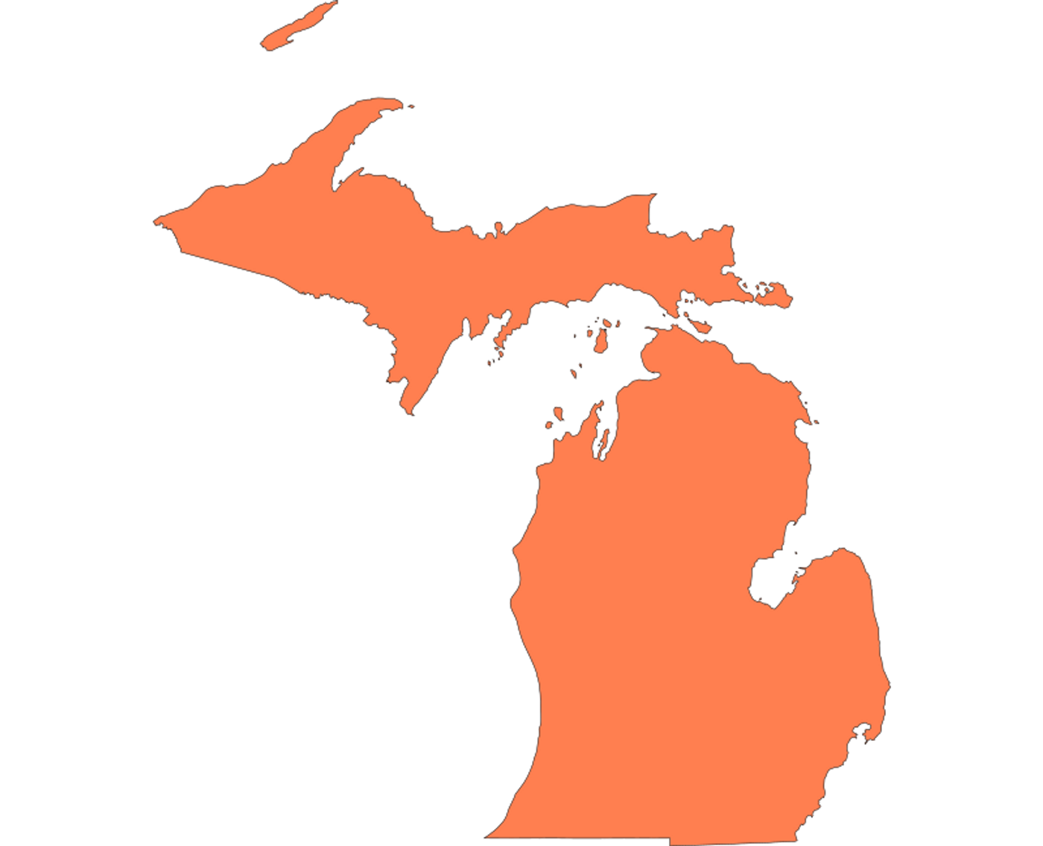
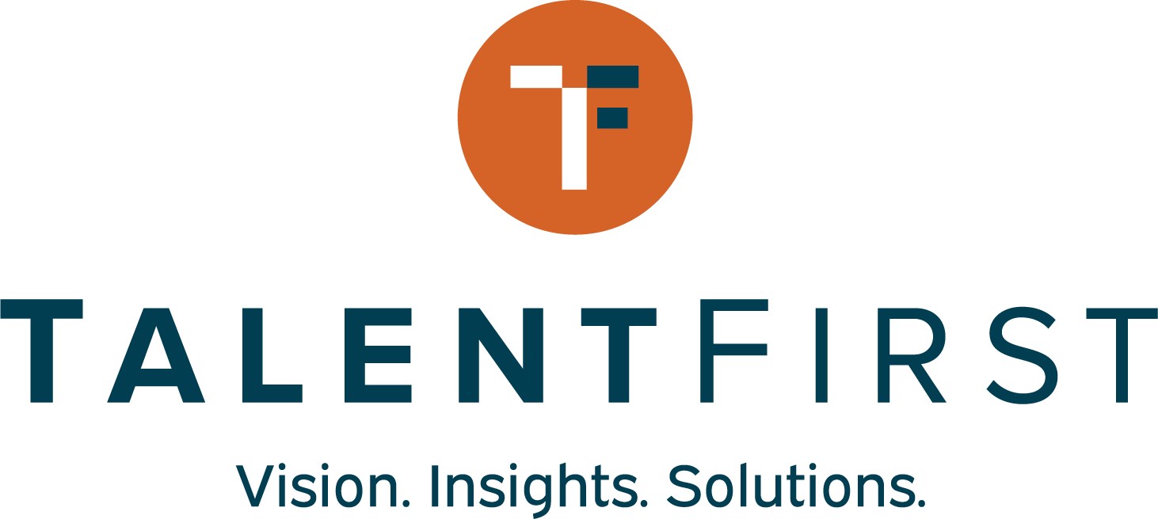
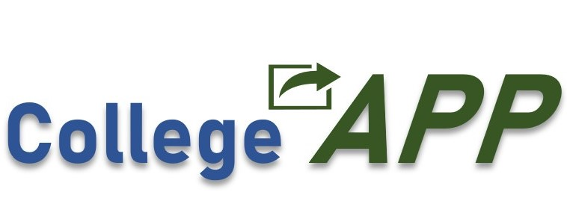
Michigan Regional Adult Initiative
for Skills and Education (MI-RAISE) Design Lab
Convening
December 12, 2023
Notes:
Jeremy
-Please go to the upper right corner of your pic or to your name on the participant list and rename yourself to include your institution
-This is the first of several workshops designed to share strategies and promising practices that can help your institution identify focal areas you may want to develop as part of a grant proposal and your college’s overall approach to increasing recruitment, enrollment, persistence, and completion for adult learners.
We’ll share a few reminders about the process, timeline, partners, and next steps.
-We’re excited that you’re here, and we’re looking forward to diving in.
-

Slide 2
Welcome!
In the chat…
Please share your favorite thing about the first snowfall of the season ❄️?

Slide 3
Agenda
***Please rename your pin with your organization.***
Welcome and Updates
Understanding and Supporting Adult Learners
Peer Learning Breakouts
Next Steps
MI-RAISE Design Lab
Notes:
Jeremy
-------
AK suggested talking points for Jeremy’s opening
Goal of the MI-RAISE Design Lab
--The goal of this 6 month process is to help you and your colleagues build strong, strategic, actionable plans for significantly enhancing and improving your ability to serve adult learners.
In the near future, starting with but not limited to, the first round of IIA grants, resources will be made available to support institutional capacity for more effectively meeting the needs of adult learners. To be competitive for these resources, institutions and partnerships will need to demonstrate that they have undertaken a careful, planful process in developing proposals. The MI-RAISE Design Lab has been designed to provide a light, but structured process for building out strong project plans.
--The reason we’re taking this approach is because we know from listening to you in a variety of settings that 1) you need resources to do important work, 2) you don’t have a lot of time to think strategically, because you’re so busy working every day on the huge array of responsibilities you have, 3) it’s far too easy to work in silos and miss those opportunities to connect across areas in creative ways that can positively impact your students’ experiences, and 4) for most of you, even if it’s in your institutional bones, effectively meeting the diverse needs of today’s adult learners is hard work that requires next-level strategy and coordination.

Slide 4
“Action expresses priorities."
~Mohandas Gandhi, Lawyer and Political Ethicist

Slide 5
MI-RAISE Design Lab Key Partners
Michigan Center for Adult College Success - Project lead
Education Strategy Group - Technical assistance, labor market data, convening support
Sova - Design process lead, coaching, technical assistance
CollegeAPP - Adult Prospect Pipeline data mining and modeling
TalentFirst - Landscape analysis and Labor market data
Goal: To prepare post-secondary institutions to strategically utilize state grants and other potential funding opportunities.
MI-RAISE Design Lab
Notes:
Jeremy
We have a great group of partners here that are going to be working together behind the scenes and with you in a coordinated way to provide you with the information, ideas, and support you need to build strong, grounded proposals. The Center is the lead and we’re excited to be in this work (insert ½ a sentence on the Center’s origin and charge).
Education Strategy Group, through a Kresge Foundation grant, is bringing their expertise to provide grounding for the Design Lab participants, to help produce labor market data for participating institutions, and to provide convening support and network learning opportunities. They have created a self-assessment tool that you’ll be provided with and around which you’ll have one 60-90 minute grounding session before the end of the year. Our ESG colleagues will tell you more about that in a moment, but know that the self-assessment discussion will not be an onerous process, but a discussion. You’ll have the opportunity to prepare for the session, but no preparation will be required.
Sova is the design process lead and their team will be working individually with your institutions to tailor a process that will result in compelling, strategic, actionable, grounded proposals for the IIA. In a couple of minutes here, you’ll hear about Sova’s approach to this work, but know that Sova is committed to meeting you where you are and tailoring a process that feels light, fits within the realities of your team’s busy lives, and that helps you build the strongest possible proposals by May.
CollegeAPP will be providing Adult Prospect Pipeline data mining and modeling to help you think strategically and broadly about the opportunities you have in your service region. Additional data analysis of this kind will be helpful to you in the work of building strong, grounded proposals.
TalentFirst will be working with ESG and CollegeAPP to extend our collective capacity to provide you with good information about the broader landscape that your institutions are operating in and the labor market opportunities that exist in your service region.
While the support has been assembled specifically for the purpose of readying institutions to apply for IIA and other grants, we think the insights and support provided by the partners will be of wider benefit to you and your colleagues.

Slide 6
The MI-RAISE Design Lab Cohort
Alpena Community College
Bay College
Central Michigan University
Ferris State University
Glen Oaks Community College*
Grand Valley State University
Jackson College
Kalamazoo Valley Community College**
Lansing Community College
Mott Community College
Muskegon Community College
Northern Michigan University
University of Olivet*
Western Michigan University**
Kalamazoo Promise**
*Partnering colleges; **Partnering organizations

Slide 7
Important Dates
Early January: Design sprint kick-off sessions with Sova and each college team
January 23, 2023: In-person convening 10am-3:30pm (10:30am start time)
Hosted by Grand Valley State University
Topic: Recruiting Adult Learners; Data Sensemaking & Asset Mapping
February 13, 2023: Virtual convening starting @ 12 ET
Topic: Seamless Pathways that Accelerate; Prioritization & Partnerships
March: Innovation Investment Award (IIA) RFP Released
March 21, 2023: In-person convening 10am-3:30pm (10:30am start time) ET
Location TBD
Topic: Holistic Supports; Theory of Change & Action
April 16, 2023: Virtual convening @ 12 ET
Topic: Milestones & Metrics, Implementation Planning
May: Innovation Investment Award (IIA) Proposals Due
MI-RAISE Design Lab

Slide 8
Understanding and Supporting Adult Learners

Slide 9
Our objectives for today:
1
Make the case for why adults learners are key for building a more prosperous, equitable Michigan
2
Uplift priorities to equitably serve adults, including strategies and actions
Create space for participants to learn from one another on how they serve adult learners and ways they can improve their support.
3

Slide 10
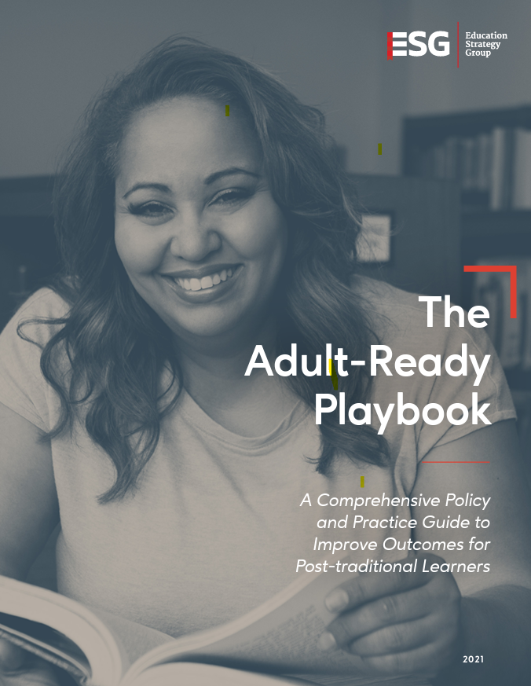
Defining Adult Learners
Adult learners tend to be defined as those at or over the age 25 beginning or restarting their path to their first credential
Nontraditional-learners have one or more characteristics that are considered “non-traditional” in higher education
Post-traditional learner is a term that offers more humanizing language and acknowledges that students with “nontraditional” characteristics are now the norm in postsecondary education.
Who do we mean by “adult”? Individuals with high school diploma or equivalency and are one year or more removed high school and, for data purposes, usually use 25 and older
Notes:
Let’s start with the definition of an adult learner
The term adult learner is a bit funny because our government recognizes you as an adult at 18 and the overwhelming majority of college students are over that age
The field tends to define adult learners, although this isn’t an ironclad definition, as someone beginning or restarting their postsecondary education at or over the age of 25
These individuals are also sometimes referred to as nontraditioal learners because they have 1 or more characteristics that are considered non-traditional in higher education
●Filing independent
●Parent
●Veteran
●Working
●Attending part-time
Often these two are synonymous because the research shows that age is a pretty good proxy for one or more of these characteristics
Now at ESG we prefer the term posttraditional over nontraditional for two reasons
It offers up more humanizing language for these students
Recognizes that non-traditional is the new traditional - something like 60-70% of college students today have
In MI, 2.5M adults lack postsecondary credential (nearly half of adults in MI)

Slide 11
The Diverse and Multifaceted Adult Learner
Degree or certificate holders
Some college, No Degree
Skill-Seeking
GED holders
Perhaps the tie that binds this diverse population of learners together most aptly is a nearly universal desire to strive for themselves and their families.
Parents
Veterans
Immigrants
Justice-impacted

Slide 12
Demographic trends suggest adult learners will be even more critical to our workforce

Slide 13
And in the last year, adult learner enrollment in postsecondary has increased
Enrollment is growing for learners over the age of 30.

Slide 14
But learners are specifically interested in short-term training...

Slide 15
...yet we know longer-term training tends to lead more reliably to employment and better wage outcomes.
Employment rates
77%
Short-term
84%
Associate's
87%
Bachelor's
(New America, 2021)

Slide 16
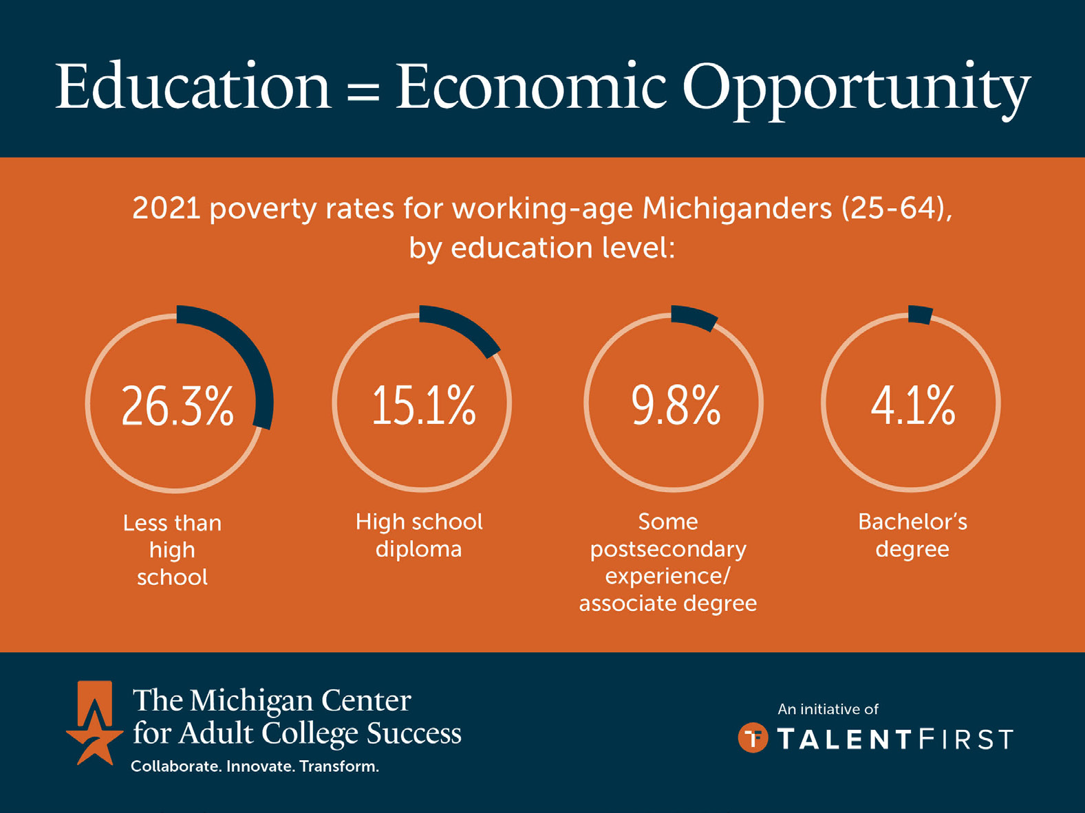
Why Adult Learners Matter in Michigan

Slide 17
Why Adult Learners Matter in Michigan

Slide 18
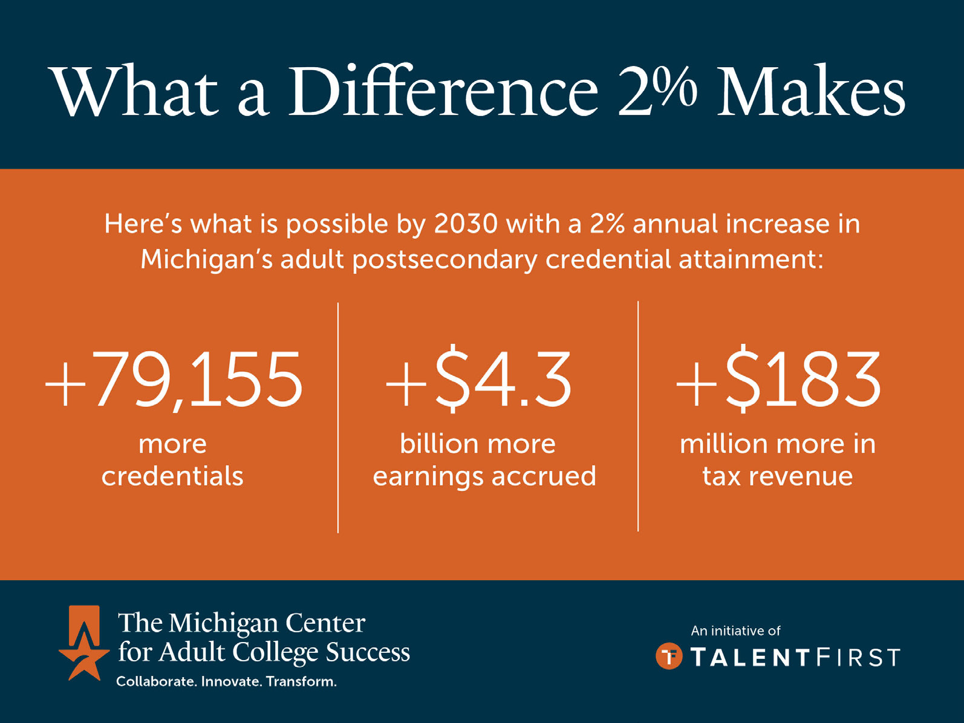
Why Adult Learners Matter in Michigan

Slide 19
Priorities for Adult-Ready Transformation
ACCESSIBILITY: Post-traditional learners effectively access and move through postsecondary programs.
PROGRAM CHANGE: Post-traditional learners thrive and feel engaged within postsecondary classrooms.
OPERATIONAL CHANGE: Post-traditional learners easily navigate postsecondary advising and administrative systems.
DATA: Post-traditional learners are authentically measured through data and used as a subject for ongoing improvement.
PARTNERSHIPS: Post-traditional learners seamlessly interface between higher education systems and trusted community/industry partners.
Notes:
Christine
So, let’s talk about how we do this. As we are sharing some strategies and actions, for each category, make in this document or in chat about things your institution is “Doing now? Do Differently? Obstacles?”. We will share some of these a little later.

Slide 20
ACCESSIBILITY: Post-traditional learners effectively access and move through postsecondary programs.
Strategy #1: Ensure institutional and state aid works for adult learners
Strategy #2: Use financial levers to increase postsecondary engagement and progression for key post-traditional populations
Strategy #3: Conduct comprehensive outreach to all post-traditional learners

Slide 21
ACCESSIBILITY: Post-traditional learners effectively access and move through postsecondary programs.
Strategy #1: Ensure institutional and state aid works for adult learners
Conduct broad and targeted outreach to make clear the value of a postsecondary education and the range of programs and financial aid opportunities available.
Strategy #2: Use financial levers to increase postsecondary engagement and progression for key post-traditional populations
Strategy #3: Conduct comprehensive outreach to all post-traditional learners

Slide 22
PROGRAM CHANGE: Post-traditional learners thrive and feel engaged within postsecondary classrooms.
Strategy #1: Deliver program content in adult-friendly ways
Strategy #2: Design programs for flexibility and convenience
Strategy #3: Develop pathways that leverage and support all skill and preparation levels

Slide 23
PROGRAM CHANGE: Post-traditional learners thrive and feel engaged within postsecondary classrooms.
Implement flexible scheduling, including synchronous and asynchronous options. Flexible scheduling also applies to employer strategies for upskilling current employees.
Strategy #1: Deliver program content in adult-friendly ways
Strategy #2: Design programs for flexibility and convenience
Strategy #3: Develop pathways that leverage and support all skill and preparation levels

Slide 24
PROGRAM CHANGE: Post-traditional learners thrive and feel engaged within postsecondary classrooms.
Increase use of accelerated programs to support faster career advancement and earning potential.
Strategy #1: Deliver program content in adult-friendly ways
Widen the availability/variety of support services, incl intensive advising and early warning systems, help with basic needs, and corequisite support – providing help while the student earns credits – instead of remediation
Recognize prior learning and provide credit for skills acquired outside of the classroom.
Strategy #2: Design programs for flexibility and convenience
Strategy #3: Develop pathways that leverage and support all skill and preparation levels

Slide 25
OPERATIONAL CHANGE: Post-traditional learners easily navigate postsecondary advising and administrative systems.
Strategy #1: Create a one-stop student experience
Strategy #2: Develop efficient systems for tailored student advising

Slide 26
OPERATIONAL CHANGE: Post-traditional learners easily navigate postsecondary advising and administrative systems.
Strategy #1: Create a one-stop student experience
Strategy #2: Develop efficient systems for tailored student advising
Eliminate barriers to transfer through reverse-transfer programs and
inter-institutional partnerships and program alignment.

Slide 27
DATA: Post-traditional learners are authentically measured through data and used as a subject for ongoing improvement.
Strategy #1: Strengthen data measurement and collection systems to better monitor and evaluate post-traditional learner outcomes

Slide 28
DATA: Post-traditional learners are authentically measured through data and used as a subject for ongoing improvement.
Strategy #1: Strengthen data measurement and collection systems to better monitor and evaluate post-traditional learner outcomes
Leverage high-quality data systems to monitor program success and adjust services to meet the needs of adult learners.

Slide 29
PARTNERSHIPS: Post-traditional learners seamlessly interface between higher education systems and trusted community/industry partners.
Strategy #1: Engage employers and workforce systems to promote program relevance
Strategy #2: Partner to provide critical wrap-around supports

Slide 30
PARTNERSHIPS: Post-traditional learners seamlessly interface between higher education systems and trusted community/industry partners.
Strategy #1: Engage employers and workforce systems to promote program relevance
Partner with employers to create guided, career-aligned pathways through postsecondary education to simplify progression and ensure degrees and credentials meet the educational and career goals of adults.
Strategy #2: Partner to provide critical wrap-around supports

Slide 31
Peer Learning Breakouts

Slide 32
Doing now? Do Differently? Obstacles?
ACCESSIBILITY: Post-traditional learners effectively access and move through postsecondary programs.
PROGRAM CHANGE: Post-traditional learners thrive and feel engaged within postsecondary classrooms.
OPERATIONAL CHANGE: Post-traditional learners easily navigate postsecondary advising and administrative systems.
DATA: Post-traditional learners are authentically measured through data and used as a subject for ongoing improvement.
PARTNERSHIPS: Post-traditional learners seamlessly interface between higher education systems and trusted community/industry partners.
Notes:
Christine
Now it’s time to hear from you.

Slide 33
Next Steps
Complete your individual self-assessment before your institutional reflection session
Schedule your institutional self-assessment reflection session before December 20th (60-90 minutes for your core team)
Come to your reflection session ready to schedule a January design sprint kick-off meeting with Sova
Hold January 23 10am-3:30pm for in-person convening and February 13 12n-1:30pm for virtual convening, and invite your core team to both
MI-RAISE Design Lab
Notes:
Jeremy
AK suggested talking points for Jeremy:
Following this meeting, possibly in your inbox right now, you’ll find a sign up sheet for your initial self-assessment reflection session that we’re asking each of your teams to participate in before the end of the year. At that meeting you’ll also be asked to schedule your design sprint kick-off with Sova in January, so please come to that meeting with your team’s January availability.
And finally, please be sure to mark your calendars for the virtual convening on December 12 and the in-person meeting January 17

Slide 34
Q & A
Contact us:
TheCenter@talentfirst.net
.
Notes:
Jeremy
We’re happy to answer questions now and, should you have questions following this meeting, feel free to reach out and we’ll make sure to direct your question to the right person.

